Slide 1
Ananta: Cloud Scale Load Balancing
Parveen Patel
Deepak Bansal, Lihua Yuan, Ashwin Murthy, Albert Greenberg,
David A. Maltz, Randy Kern, Hemant Kumar, Marios Zikos,
Hongyu Wu, Changhoon Kim, Naveen Karri
Microsoft

Slide 2
Windows Azure - Some Stats
More than 50% of Fortune 500 companies using Azure
Nearly 1000 customers signing up every day
Hundreds of thousands of servers
We are doubling compute and storage capacity every 6-9 months
Azure Storage is Massive – over 4 trillion objects stored
Global datacenters
Global CDN
Notes:
It works, and it’s huge
Stats released in April
Sites, numbers fast growth … quite stale

Slide 3
Ananta in a nutshell
Is NOT hardware load balancer code running on commodity hardware
Is distributed, scalable architecture for Layer-4 load balancing and NAT
Has been in production in Bing and Azure for three years serving multiple Tbps of traffic
Key benefits
Scale on demand, higher reliability, lower cost, flexibility to innovate

Slide 4
How are load balancing and NAT used in Azure?

Slide 5
Background: Inbound VIP communication
Terminology:
VIP – Virtual IP
DIP – Direct IP
Internet
Client → VIP
LB
VIP = 1.2.3.4
Client → DIP
LB load balances and
NATs VIP traffic to DIPs
Front-end
VM
Front-end
VM
Front-end
VM
DIP = 10.0.1.1
DIP = 10.0.1.2
DIP = 10.0.1.3
Notes:
Same things happen between the front-end and back-end

Slide 6
Background: Outbound (SNAT) VIP communication
Datacenter
Network
1.2.3.4 → 5.6.7.8
LB
LB
VIP1 = 1.2.3.4
VIP2 = 5.6.7.8
DIP → 5.6.7.8
VIP1 → DIP
Front-end
VM
Back-end
VM
Front-end
VM
Front-end
VM
Front-end
VM
DIP = 10.0.1.1
DIP = 10.0.1.20
DIP = 10.0.2.1
DIP = 10.0.2.2
DIP = 10.0.2.3
Service 1
Service 2

Slide 7
VIP traffic in a data center
Notes:
- This is just the current usage. In reality, we expect the intra-DC VIP traffic to increase faster and that is what we have provisioned for.

Slide 8
Why does our world need yet another load balancer?

Slide 9
Traditional LB/NAT design does not meet cloud requirements
Requirement | Details | State-of-the-art
Scale | Throughput: ~40 Tbps using 400 servers 100Gbps for a single VIP Configure 1000s of VIPs in seconds in the event of a disaster | 20Gbps for $80,000 Up to 20Gbps per VIP One VIP/sec configuration rate
Reliability | N+1 redundancy Quick failover | 1+1 redundancy or slow failover
Any service anywhere | Servers and LB/NAT are placed across L2 boundaries for scalability and flexibility | NAT and Direct Server Return (DSR) supported only in the same L2
Tenant isolation | An overloaded or abusive tenant cannot affect other tenants | Excessive SNAT from one tenant causes complete outage

Slide 10
Key idea: decompose and distribute functionality
VIP Configuration:
VIP, ports, # DIPs
. . .
Software router
(Needs to scale to Internet bandwidth)
Multiplexer
Multiplexer
Multiplexer
Controller
Controller
Ananta
Manager
VM Switch
VM Switch
VM Switch
Hosts
(Scales naturally with
# of servers)
Host Agent
Host Agent
Host Agent
. . .
. . .
. . .
. . .
VM₁
VM_{N}
VM₁
VM_{N}
VM₁
VM_{N}
Notes:
- High-level design SLBM, Mux and HP

Slide 11
Ananta: data plane
1st Tier: Provides packet-level (layer-3) load spreading, implemented in routers via ECMP.
2nd Tier: Provides connection-level (layer-4) load spreading, implemented in servers.
Multiplexer
Multiplexer
. . .
Multiplexer
VM Switch
VM Switch
VM Switch
Host Agent
Host Agent
Host Agent
3rd Tier: Provides stateful NAT implemented in the virtual switch in every server.
. . .
. . .
. . .
. . .
VM₁
VM_{N}
VM₁
VM_{N}
VM₁
VM_{N}

Slide 12
Inbound connections
Packet
Headers
Dest:
VIP
Src:
Client
Dest:
DIP
Src:
Mux
Dest:
VIP
Src:
Client
Host
Router
2
4
…
Router
Router
MUX
Host Agent
MUX
3
1
MUX
5
8
VM
DIP
Client
7
6
Dest:
Client
Src:
VIP
Packet
Headers

Slide 13
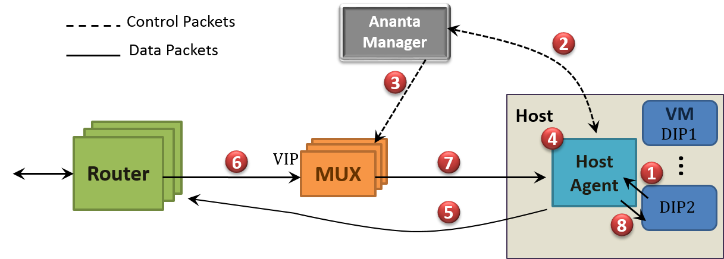
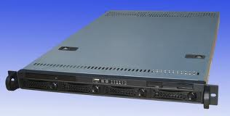
Outbound (SNAT) connections
VIP:1025 → DIP2
Server
Packet
Headers
Dest:
Server:80
Src:
VIP:1025
Dest:
Server:80
Src:
DIP2:5555
Notes:
- Show packet formats

Slide 14
Managing latency for SNAT
Batching
Ports allocated in slots of 8 ports
Pre-allocation
160 ports per VM
Demand prediction (details in the paper)
Less than 1% of outbound connections ever hit Ananta Manager

Slide 15
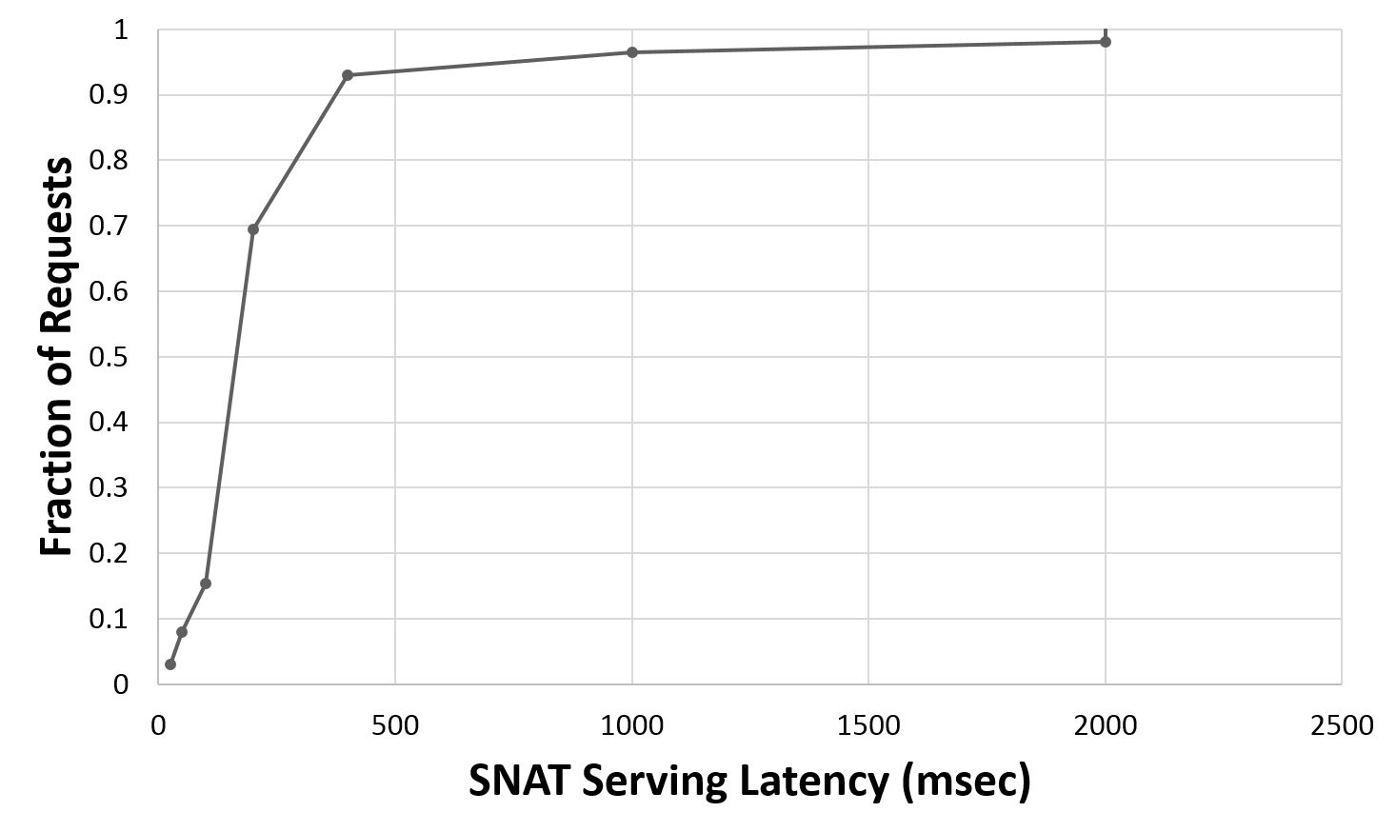
SNAT Latency

Slide 16
Fastpath: forward traffic
Host
VIP1
MUX
Host Agent
VM
MUX
MUX1
DIP1
Data Packets
…
1
SYN
Host
VIP2
MUX
Host Agent
VM
MUX
2
MUX2
DIP2
…
Destination
Notes:
- Show packet formats

Slide 17
Fastpath: return traffic
Host
VIP1
MUX
Host Agent
VM
MUX
4
MUX1
DIP1
Data Packets
…
1
SYN
3
SYN-ACK
Host
VIP2
MUX
Host Agent
VM
MUX
2
MUX2
DIP2
…
Destination
Notes:
- Show packet formats

Slide 18
Fastpath: redirect packets
Host
VIP1
MUX
Host Agent
VM
MUX
Redirect Packets
MUX1
DIP1
Data Packets
…
7
5
7
ACK
6
Host
VIP2
MUX
Host Agent
VM
MUX
MUX2
DIP2
…
Destination
Notes:
- Show packet formats

Slide 19
Fastpath: low latency and high bandwidth for intra-DC traffic
Host
VIP1
MUX
Host Agent
VM
MUX
Redirect Packets
MUX1
DIP1
Data Packets
…
8
Host
VIP2
MUX
Host Agent
VM
MUX
MUX2
DIP2
…
Destination
Notes:
- Show packet formats

Slide 20
Impact of Fastpath on Mux and Host CPU

Slide 21
Tenant isolation – SNAT request processing
DIP1
DIP2
DIP3
DIP4
6
Pending SNAT Requests per DIP. At most one per DIP.
5
1
2
3
4
3
Pending SNAT Requests per VIP.
VIP1
2
VIP2
1
4
Global queue. Round-robin dequeue from VIP queues. Processed by thread pool.
SNAT processing queue
3
2
4
1

Slide 22
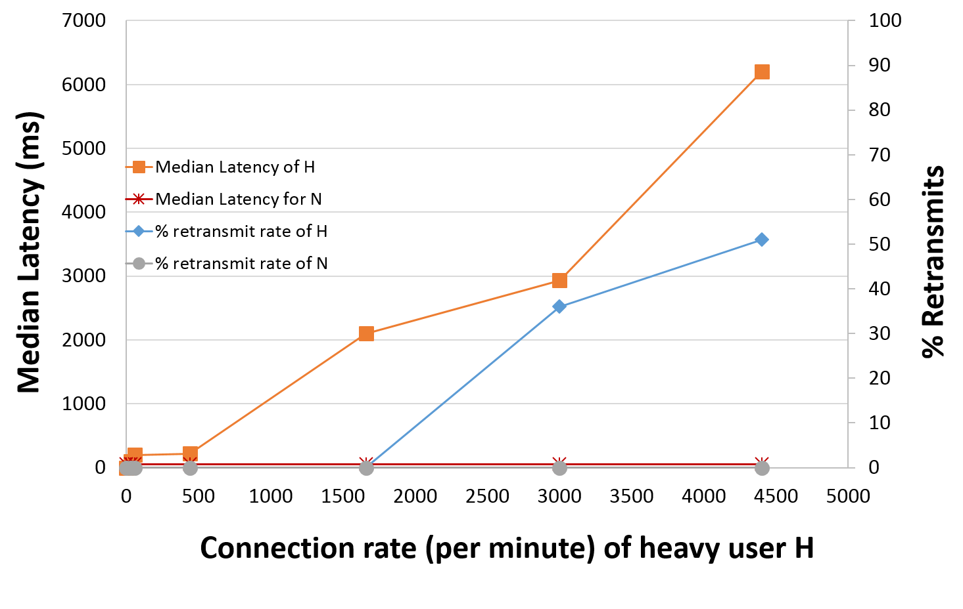
Tenant isolation

Slide 23
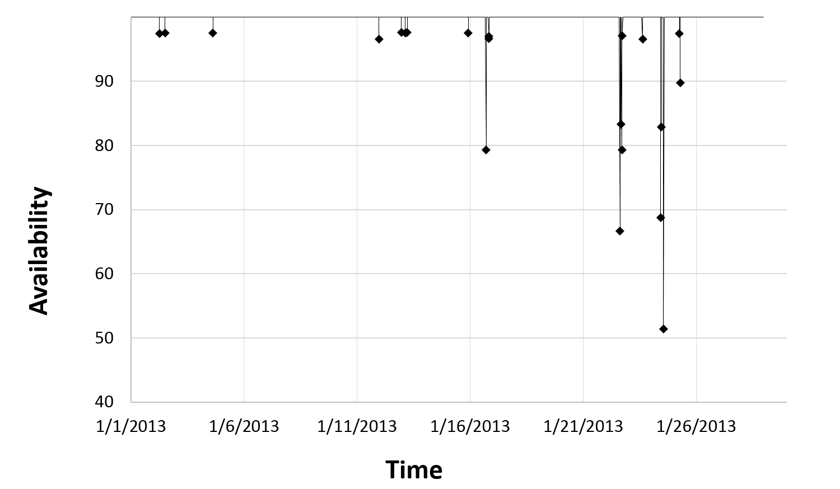
Overall availability

Slide 24
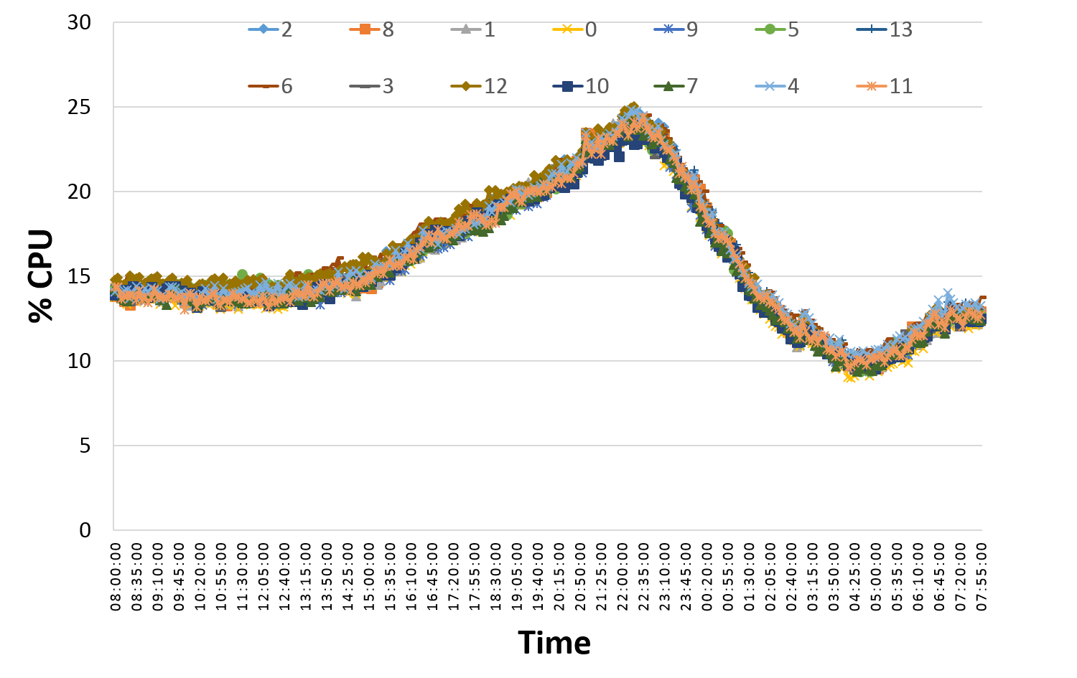
CPU distribution

Slide 25
Lessons learnt
Centralized controllers work
There are significant challenges in doing per-flow processing, e.g., SNAT
Provide overall higher reliability and easier to manage system
Co-location of control plane and data plane provides faster local recovery
Fate sharing eliminates the need for a separate, highly-available management channel
Protocol semantics are violated on the Internet
Bugs in external code forced us to change network MTU
Owning our own software has been a key enabler for:
Faster turn-around on bugs, DoS detection, flexibility to design new features
Better monitoring and management

Slide 26
We are hiring! (email: parveen.patel@Microsoft.com)

