Slide 1
Taming the Long Tail
Infrastructure for RL Post-Training
of Large Language Models
Wang Wei
CSE@HKUST
APNet 2026
1

Slide 2
Talk Roadmap
1
A Primer on RL Post-Training
Capability gains, fleet-scale cost, RLVR/GRPO stages, and synchronization
2
Long-Tail Characteristics
Heavy-tailed rollouts naturally create GPU bubbles
3
RollPacker: Single-Job RLVR
Shrink bubbles inside one strict on-policy RL job
4
Weave: Multi-Tenant RLVR
Reuse bubbles across co-scheduled RL jobs
5
RollArt: Agentic RL
Disaggregation and trajectory-level bounded asynchrony
6
Conclusion and Future Work
Toward RL-semantic infrastructure for post-training
2

Slide 3
Why Optimize RL Post-Training?
Pre-training predicts the next token; RL post-training optimizes trajectories toward task success.
Pre-training
from tokens
to outcomes
RL post-training
next-token prediction
optimize trajectories toward task success
Concrete reported gains (score %, before -> after)
Public reports expose RL scale
+62
+55.4
+36.7
+15.8
100
xAI Grok 4
200K GPUs
Qoder / RollArt
3,000+ GPUs
50
Laminar
1,024 GPUs
0
TensorHub
1,024 GPUs
OpenAI o1
AIME
DeepSeek R1
AIME
DeepSeek V4
LCB
GLM-5
MCP
RL post-training improves capability enough to become a fleet-scale infrastructure workload.
Sources: OpenAI o1 announcement; DeepSeek-R1 report; DeepSeek-V4 Table 7; GLM-5 Table 7; RL-scale sources on right.
3

Slide 4
A Typical Synchronous RL Post-Training Workflow
Each stage ends with a synchronization point: complete rollouts, complete rewards/logprobs, then sync weights.
Synchronous on-policy iteration
Each stage waits for the whole batch to finish
barrier = all workers wait
Rollout
Done
Reward
Done
Weight
Sync
Prompt
batch
1. Rollout
2. Score
3. Update
sample K responses
with policy v_t
reward, logprob,
advantage
optimize policy
then sync weights
The critical path is max rollout latency + synchronized reward/logprob + synchronized policy update.
Time Breakdown Across RL Post-Training Tasks
Rollout
Reward
Training
Math
72%
5%
23%
Code
66%
13%
21%
LLM Judge
71%
7%
22%
Rollout Dominates End-to-end Time
4

Slide 5
02
Long-Tail Characteristics
Why synchronized RL post-training suffers from significant GPU Underutilization?
Long-tailed
Latency
Heavy
Bubbles
Underutilized
GPUs
5

Slide 6
Characteristic 1: Rollout Latency Is Heavy-Tailed
Within one prompt batch, most responses finish quickly; a few long samples determine the step time.
Response length / latency distribution
Where variance comes from
CDF of rollout output lengths across reasoning workloads
Prompt difficulty, sampling, reasoning depth, and verifier behavior change latency.
CDF
tail ~100k
1.0
Why batching amplifies it
One update consumes a completed group of samples, so wall-clock time tracks the tail.
0.5
0
Step latency roughly follows max{length(resp_{i})}
0
50k
100k
Output Length
Moonlight 22k
Qwen2-VL 7.6k
Kimi-K2 39k
Length distribution redrawn from Seer Figure 2; rollout lengths span hundreds to ~100k tokens across reasoning workloads.
6

Slide 7
Characteristic 2: Synchronization Turns Tails into Bubbles
Fast rollout workers finish early, SM utilization drops, and the step waits at the synchronization barrier.
Rollout bubbles appear before every barrier
SM utilization confirms the bubble
Short responses finish early; the batch waits for the long tail.
SM Util. (%)
GPU #0
GPU #2
Rollout
Reward
Train
Idle bubble
GPU #4
GPU #6
100
GPU1
GPU2
GPU3
50
GPU4
0
0
100
200
300
idle
bubble
idle
bubble
Time (s)
Barrier turns tail latency into reserved-but-idle GPU time.
Finished GPUs drop to ~0% SM util.
long-tail rollout -> rollout bubbles -> low SM utilization
7

Slide 8
Characteristic 3: Resource Utilization Drops at Scale
Synchronous on-policy rollout falls far below linear scaling as GPU count grows.
Measured Scaling: Synchronous rollout
Why scaling makes it worse
Synchronous on-policy rollout vs. expected linear scaling
1. More rollout slots
Qwen3-8B-Think
Avg Len=11k, Max Len=32k
Qwen3-8B-Base
Avg Len=2k, Max Len=32k
Expected
linear
With more GPUs,
tail latency becomes more likely.
8
P(any tail)=1-(1-p)^N
6
N grows with GPU count
Relative Thrpt.
large gap
4x
4
3.57x
2. Barrier amplifies tails
2x
2.31x
All workers wait for slowest rollout
before reward and policy update.
2
1.57x
1.26x
1.48x
1.65x
~1.0x
0
16
32
64
128
GPU Count
At 128 GPUs: Qwen3-8B-Think 3.57x, Qwen3-8B-Base 1.65x; ideal is 8x.
Synchronous rollout preserves on-policy semantics, but exposes scale-dependent idle bubbles.
Note: Base is renormalized so 16 GPUs = 1.0.
8

Slide 9
03
RollPacker^{[NSDI ’26]}: Single-Job RLVR
Recover rollout bubbles inside one synchronized on-policy RLVR job.
Strict on-policy semantics
Tail batching
Accuracy + efficiency
Gao et al., “RollPacker: Taming Long-Tail Rollouts for RL Post-Training with Tail Batching,” in NSDI ’26.
9

Slide 10
Existing Single-Job RL Solutions Trade Accuracy for Efficiency
The target is one strict on-policy RLVR job: no stale weights, no external tenant, no quality regression.
Stage overlap under synchronization constraints, e.g.. RLHFuse [NSDI ’25]
Hides latency only when dependencies allow; the rollout barrier still waits.
Relaxed Synchronization, e.g., StreamRL, AsyncFlow, AReaL, RhymeRL
Raises utilization with stale/off-policy execution, risking accuracy for speed.
We propose tail batching to balance accuracy and efficiency
10

Slide 11
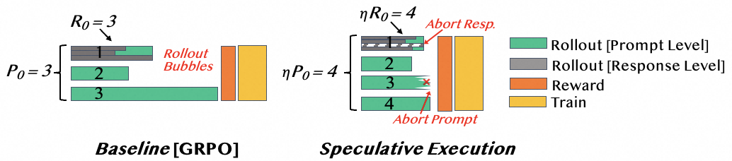
Tail Batching: Speculative Execution & Long-Prompt Queue
Move long tails off the critical path, but make sure hard prompts are still learned.
Speculative execution: launch extra work, keep the fastest valid samples
1. Over-sampling
2. Retain fast rollouts
3. Abort long-tail prompts
Long-prompt queue: the accuracy guardrail
Excluding long prompts harms model performance
No prompt should be permanently excluded
Long prompt queue triggers a long round without
speculative execution
11

Slide 12
Tail Batching: Accuracy Preserved, Rollout Efficiency Preserved
The key result is not just faster execution: the learning trajectory stays aligned.
Accuracy: validation curves align
Efficiency: fewer rollout bubbles
Reward curves show no accuracy degradation across models.
Length distribution and performance breakdown shows efficiency of tail batching
7B
32B
Tail batching statistically maintains the underlying distribution
Recent algorithmic works also reorder prompts
for efficiency
Tail batching yields shorter & more balanced responses in short rounds
Training time breakdown with tail batching
  Reward stages become non-trivial
  Both short and long rounds still contribute substantially to total latency
Same on-policy contract; fewer idle GPUs at the rollout barrier.
12

Slide 13
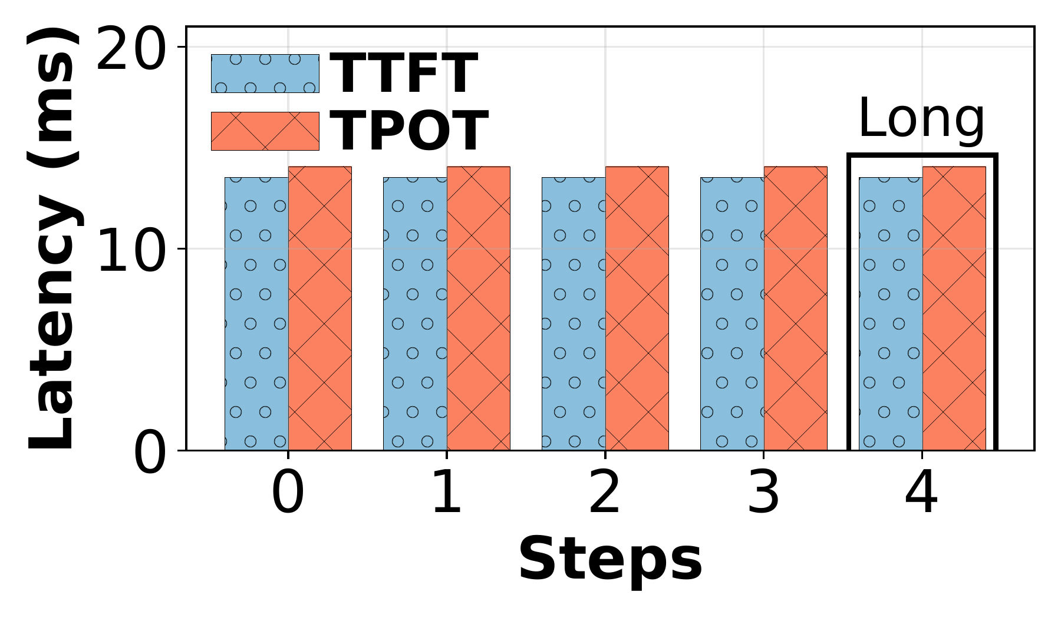
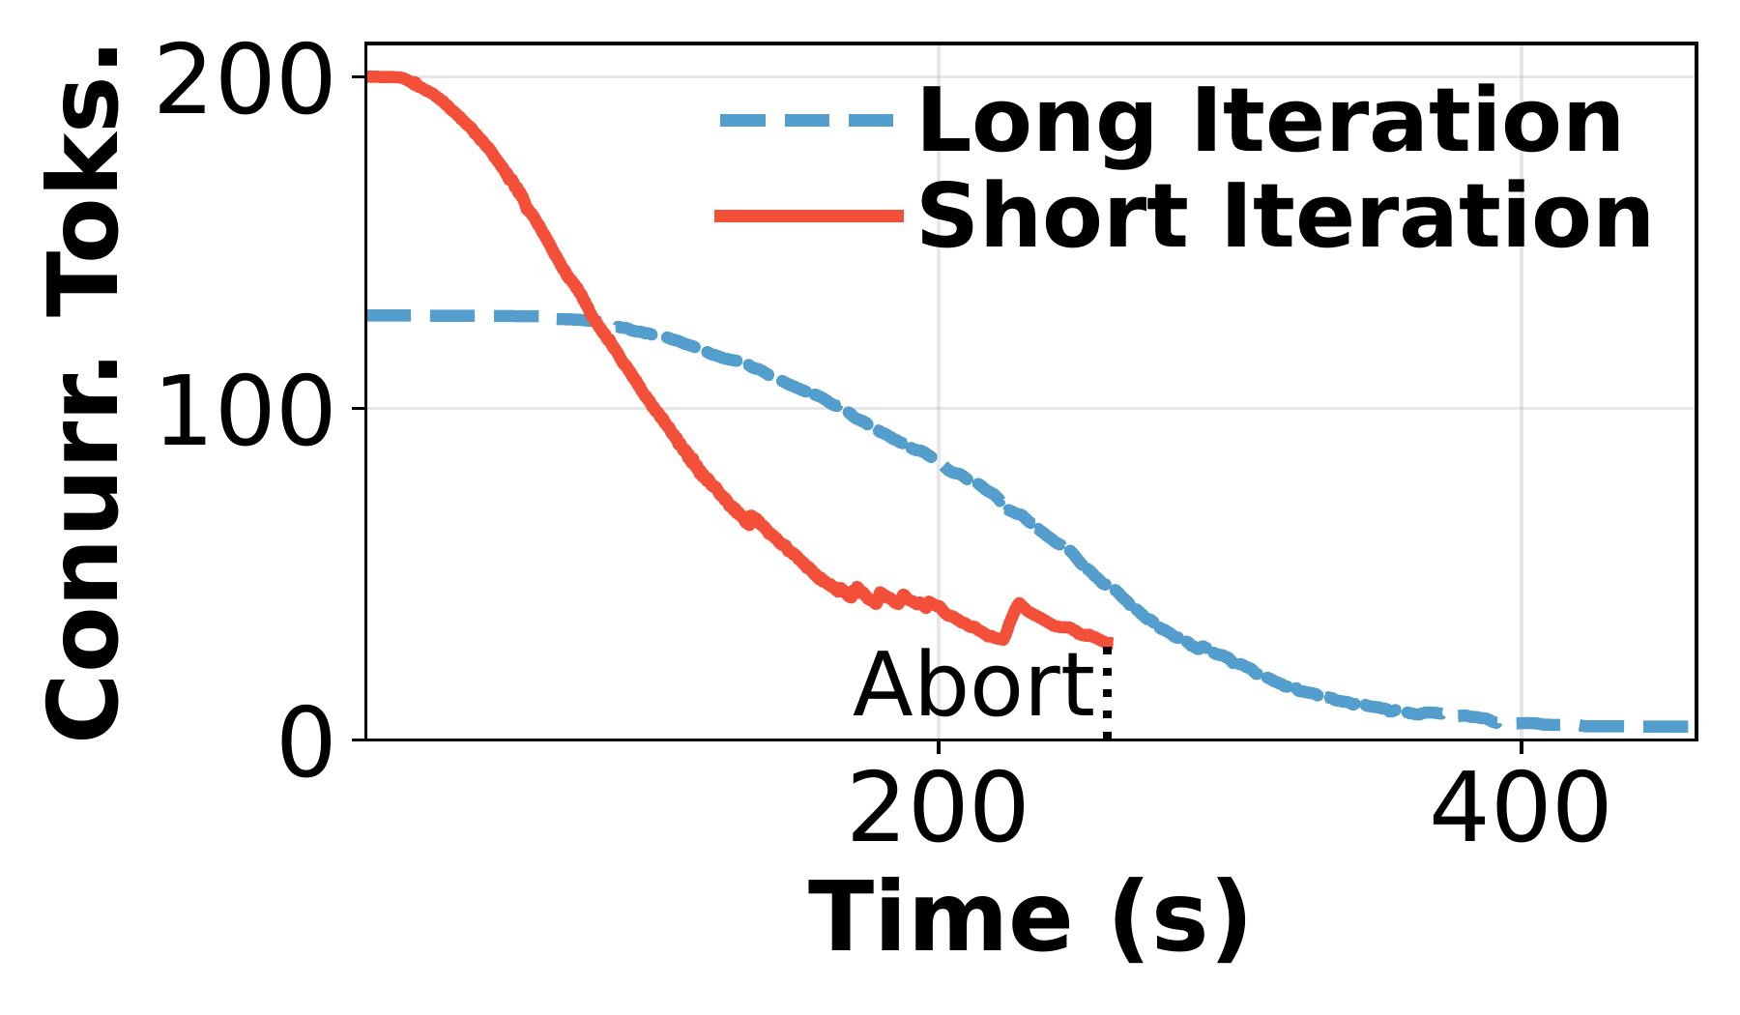
Tail Batching Introduces KV-Cache Overhead
Speculation shortens rollout tails, but extra concurrent requests shift pressure to KV cache.
Latency cost
KV-cache pressure
Implication
Speculative execution adds negligible rollout latency.
Short rounds carry more concurrent tokens.
System optimizations must manage memory, not only time.
Rollout Latency
Concurrent Rollout Tokens
Takeaway: KV-cache-aware scheduling becomes necessary.
13

Slide 14
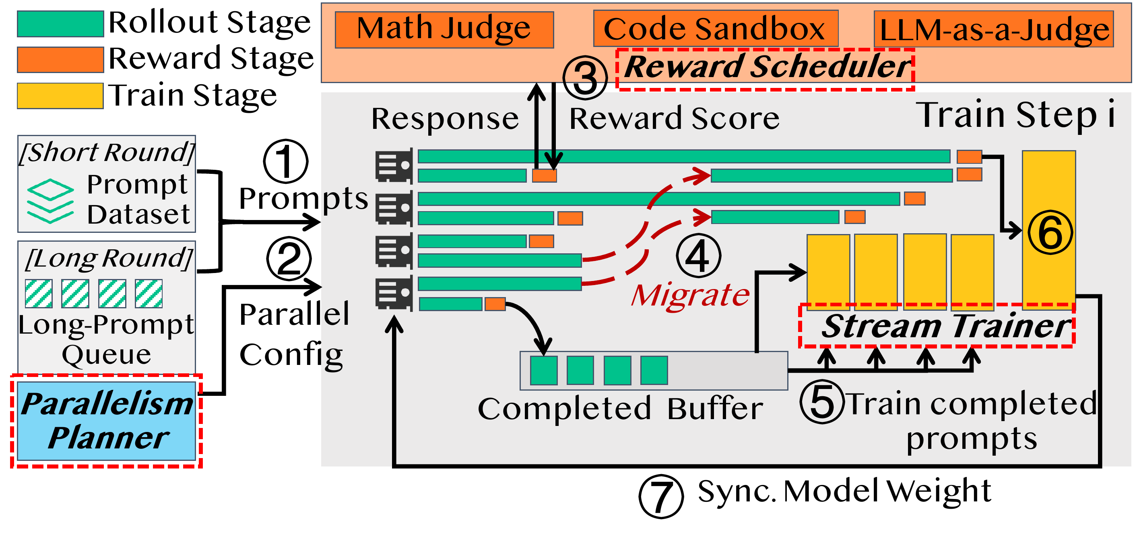
System Overview & Workflow
RollPacker wraps tail batching with system components that handle memory, reward, and training overlap.
Three designated system optimizations in RollPacker
Parallelism Planner
Reward Scheduler
Stream Trainer
14

Slide 15
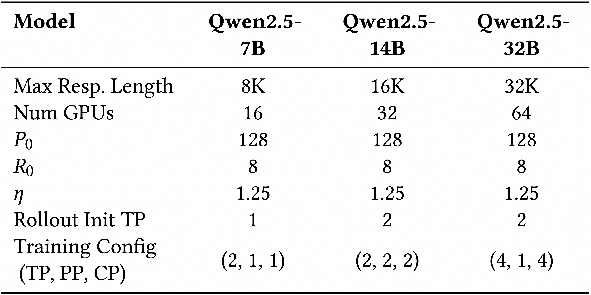
Evaluation Setup
Matched RLVR workloads across model scale, context length, and baseline systems.
Tasks
Workload matrix
Code, Math
LLM-as-a-Judge
Cluster
16 x 8 H800 GPUs
400Gbps InfiniBand
Baselines
veRL (EuroSys'25)
RLHFuse (NSDI'25)
Metric
End-to-end
training time
Evaluation scales from 7B/8K on 16 GPUs to 32B/32K on 64 GPUs.
15

Slide 16
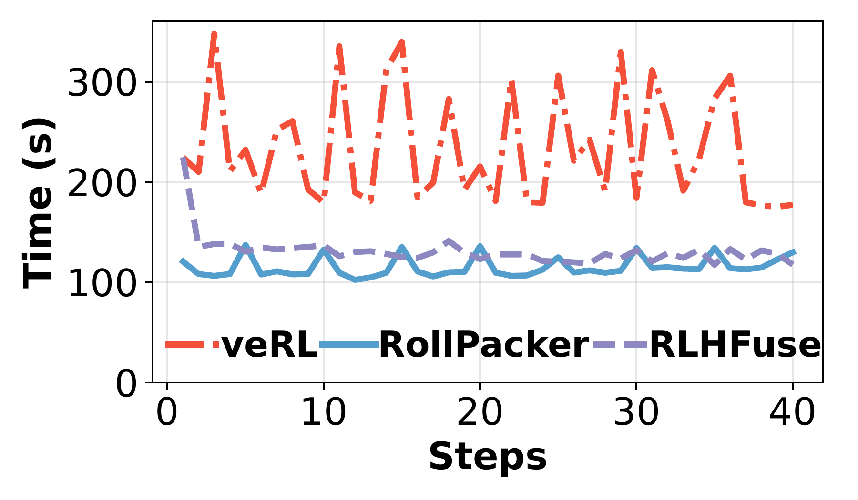
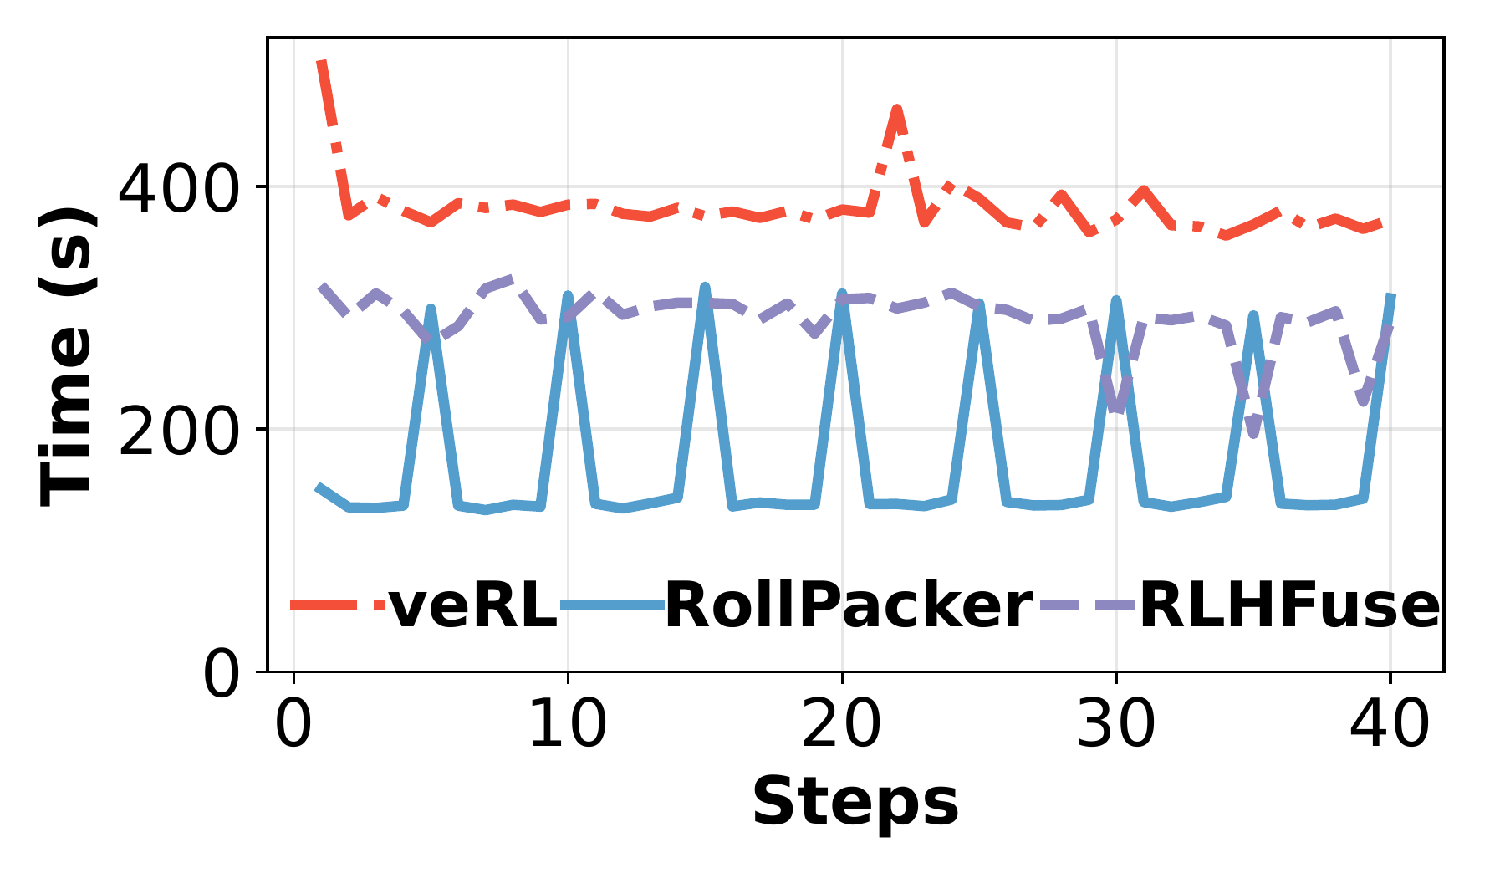
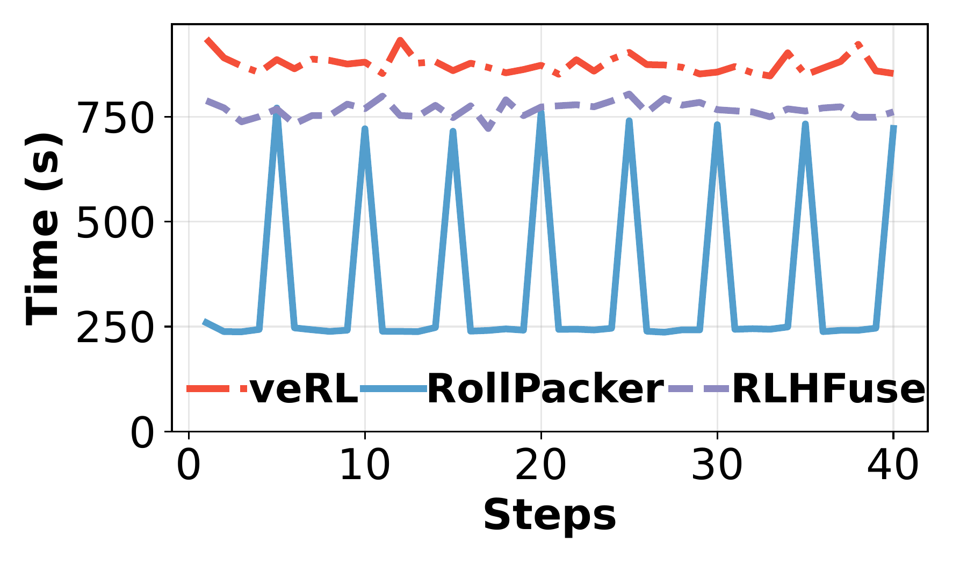
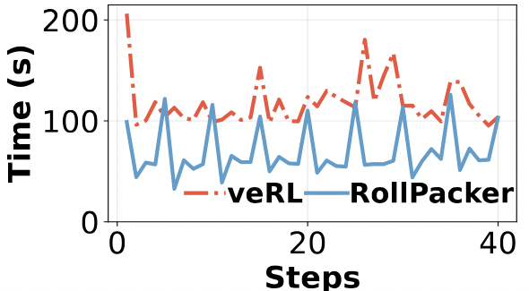
End-to-End Evaluation
Step-time gains across model scales; bounded async is shown with step time only.
7B / 8K
14B / 16K
32B / 32K
Bounded Async Training (One-Step Off Policy)
Takeaway: RollPacker lowers critical-path step time under the same RLVR semantics.
16

Slide 17
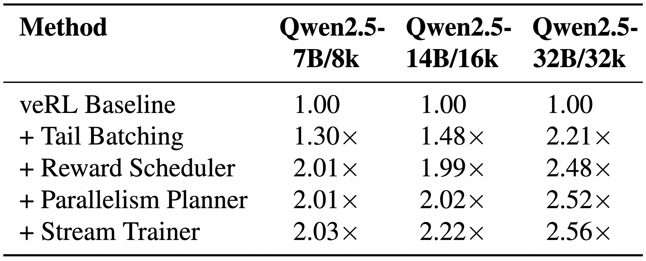
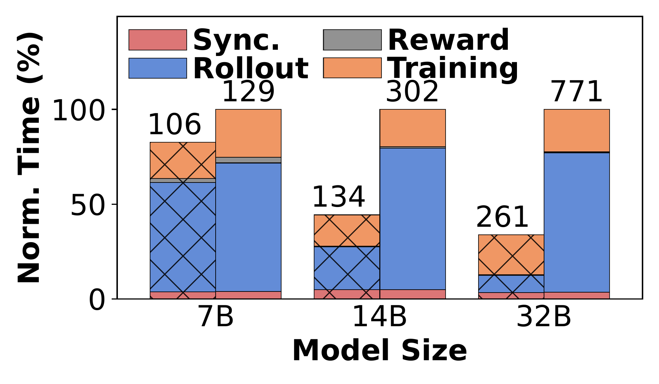
Microbenchmarks
Ablations isolate where the speedup comes from and how it changes across workloads.
What each component contributes
Tail batching grows with response length; scheduler/planner/trainer compound the gain.
Ablation speedup over veRL baseline
Step time breakdown
Tail Batching: 2.21x at 32B/32K
Short rounds reduce step time.
17

Slide 18
04
Weave ^{[OSDI ’26]} : Multi-Tenant RLVR
Fill dependency bubbles across co-scheduled RLVR jobs in shared, multi-tenant clusters.
Co-execution groups
Marginal-cost placement
Cluster-level utilization
Wu et al., “Weave: Efficient Co-Scheduling for Disaggregated RL Post-Training,” in OSDI ’26.
18

Slide 19
Disaggregation Matches Hardware, but Exposes Bubbles
Rollout and training prefer different GPU pools; on-policy dependencies serialize their progress.
Hardware specialization
Dependency bubbles
Rollout is serving-like; training is compute-heavy.
Rollout
rollout
idle
GPU
TFLOPS
HBM
Cost
Training
idle
train
H20
148
96GB
$1.85/h
A strict on-policy step makes the next phase wait for the previous phase, so one hardware pool is idle while the other is active.
H800
989.5
80GB
$5.28/h
- Use H20-style memory-rich GPUs for rollout.
- Keep H800-style compute GPUs for training.
GPU idle becomes cluster idle.
Preserve on-policy semantics while reducing cluster-wide idle bubbles.
20

Slide 20
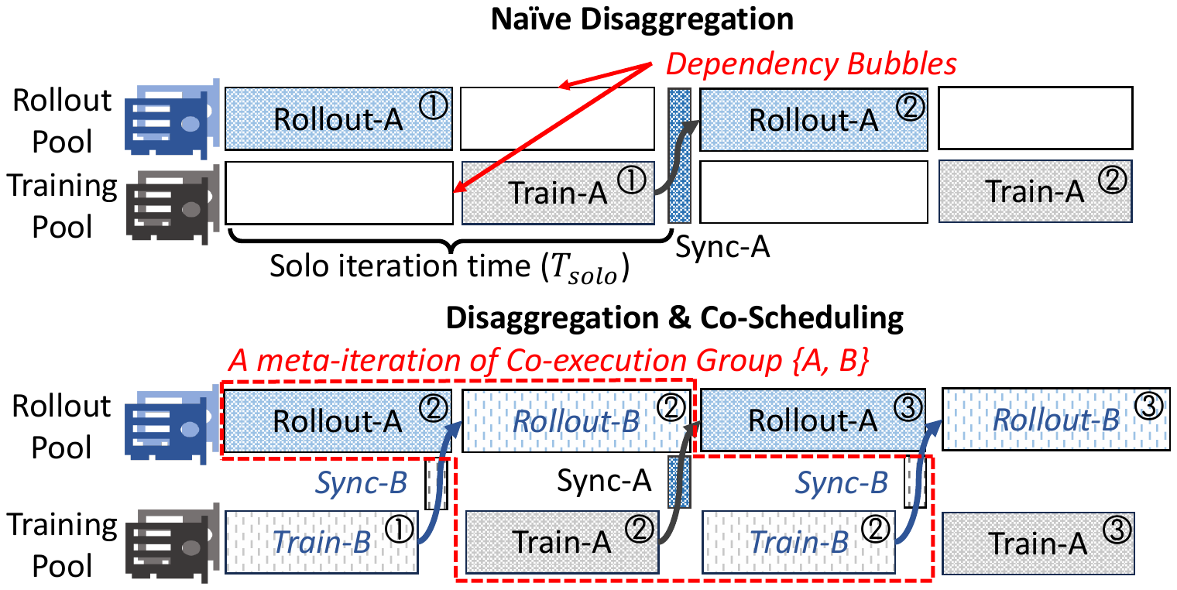
Weave: Co-Scheduling RLVR Jobs
Phase-level co-scheduling turns on-policy bubbles into useful cluster work.
One job has bubbles; a cluster has complementary jobs
Cluster opportunity
- Many RLVR jobs run concurrently.
- Different jobs spend time in different phases.
- Fill one job's wait time with another job's rollout or training.
Weave jobs, not steps.
Solo disaggregation exposes rollout/training dependency bubbles; co-scheduling overlaps other jobs' active phases.
Multi-tenant RLVR exposes scheduling freedom hidden by a single-job view.
19

Slide 21
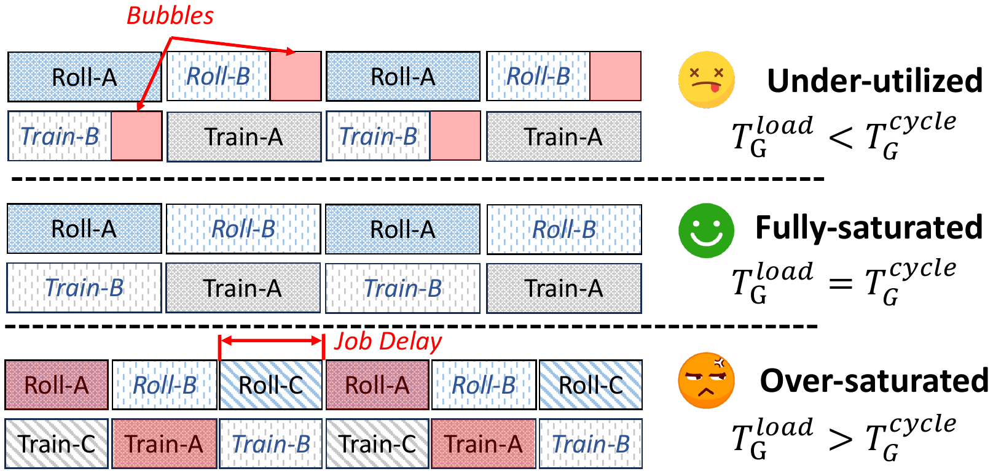
Key Abstraction: Co-Execution Groups
Weave decomposes global multi-job scheduling into placement between groups and ordering inside a group.
What is a group?
Which groups are safe to admit?
- A small set of RLVR jobs.
- Shared rollout and training pools.
- Pinned placements and cached actor states.
- One runtime envelope for scheduling.
Job A
Job B
Job C
- Under-utilized groups have bubbles to absorb work.
- Full groups preserve SLO but offer little slack.
- Over-saturated groups risk slowdown.
Rollout
pool
Training
pool
21

Slide 22
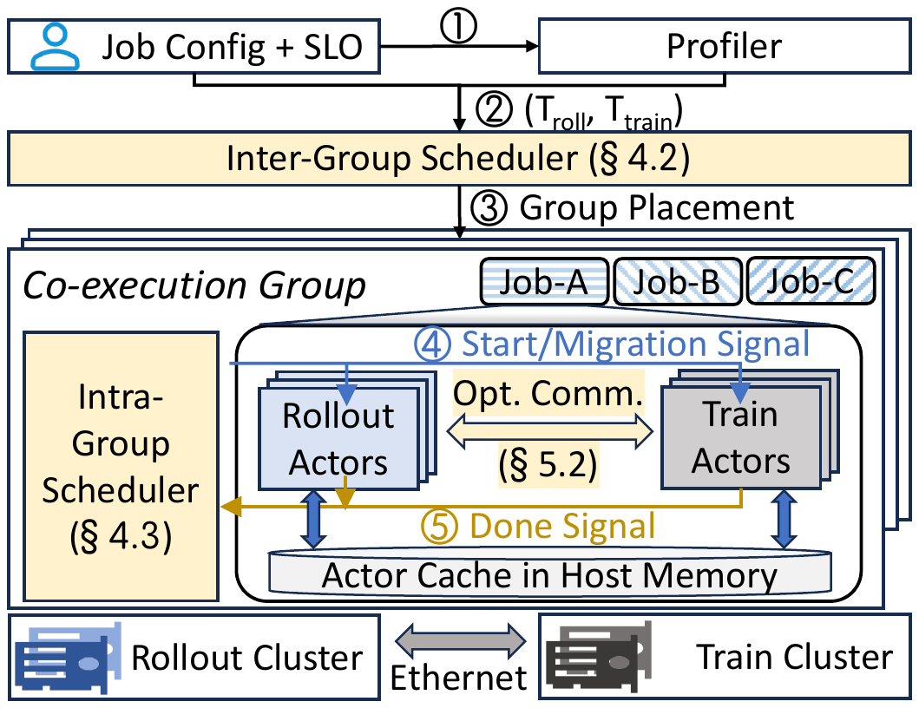
Weave System Architecture
A global scheduler, group scheduler, runtime hooks, and model-sync path coordinate disaggregated RLVR.
System overview
Control responsibilities
- Inter-group scheduler admits jobs into groups.
- Intra-group scheduler runs round-robin meta-iterations.
- Runtime hooks expose rollout, training, sync, and migration.
- Topology-aware sync keeps rollout weights fresh.
Scheduler + runtime hooks.
22

Slide 23
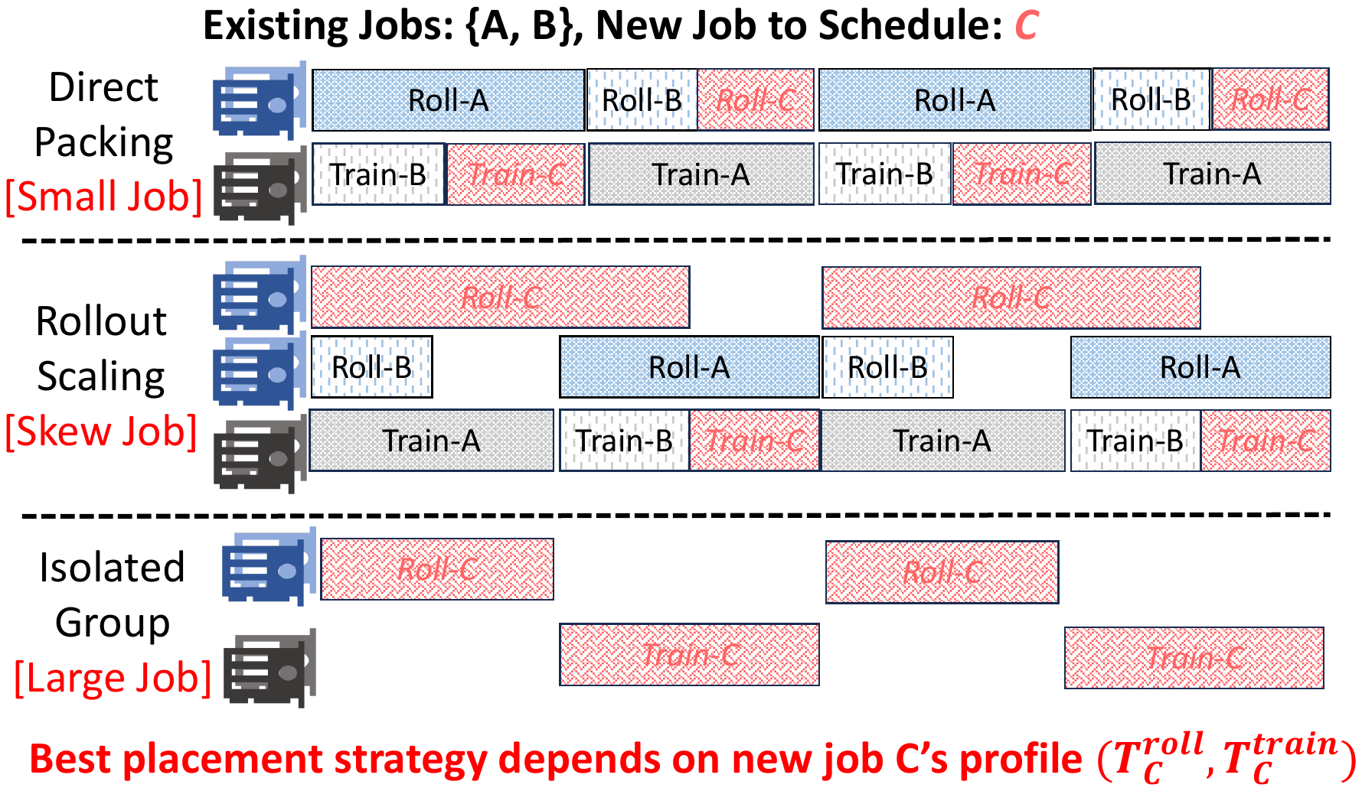
Inter-Group Scheduler: Pack by Marginal Cost
For each arriving job, Weave searches placements that satisfy SLO and memory-residency constraints.
Placement search
Candidate order
1
Direct packing
reuse current pools
2
Rollout scaling
add cheap rollout GPUs
3
New group
isolated fallback
SLO + memory must pass
Minimize marginal cost while keeping every job within its SLO.
23

Slide 24
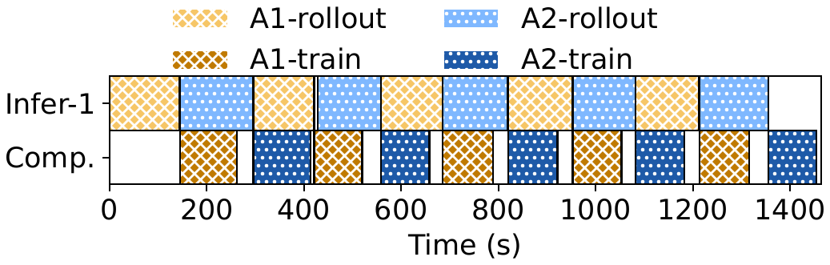
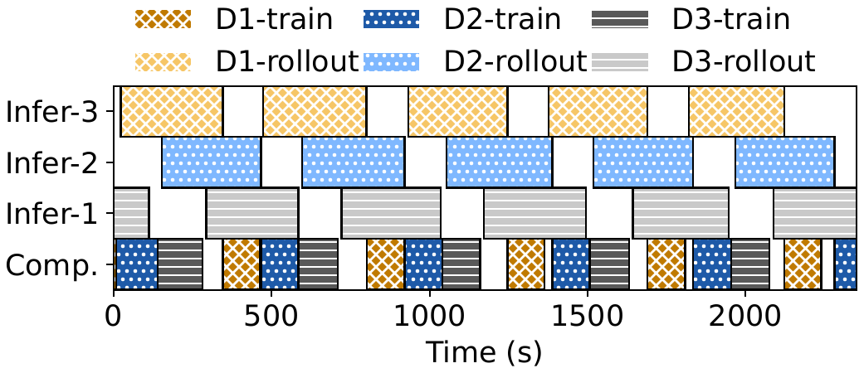
Intra-Group Scheduler: Round-Robin
Inside a non-overloaded group, each job gets one rollout and one training phase per meta-iteration.
Direct-packed group
Rollout-scaled group
Balanced phases fill most dependency bubbles without solving a global ordering problem.
When rollout is the bottleneck, extra rollout capacity creates feasible group cycles.
Round-robin is easy to simulate and effective for non-overloaded groups.
24

Slide 25
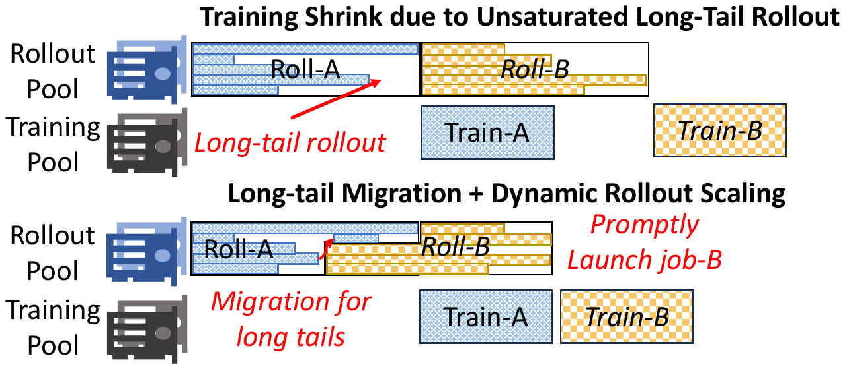
Runtime Optimization: Migrate Long-Tail Rollouts
When a few rollout requests lag behind, Weave consolidates tails and starts the next job early.
Long-tail migration
Why it matters
- Rollout durations are stochastic.
- Most requests finish early.
- A few stragglers fragment
rollout GPUs.
- Migrating tails frees GPUs
for the next rollout.
Runtime repair is needed because admission cannot predict every tail.
25

Slide 26
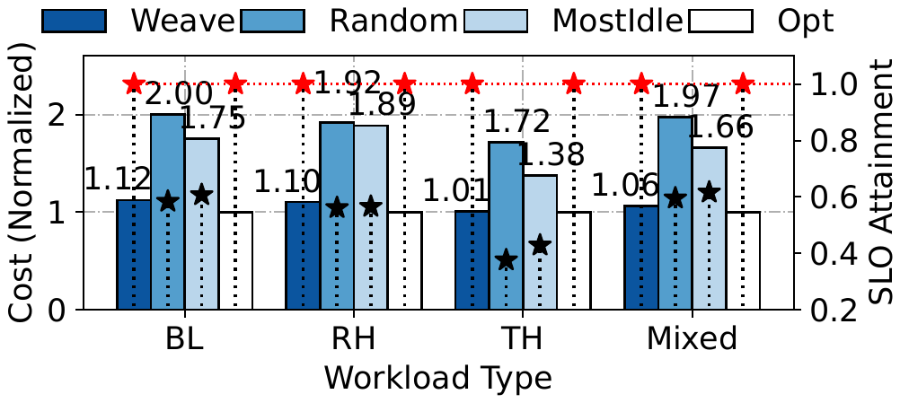
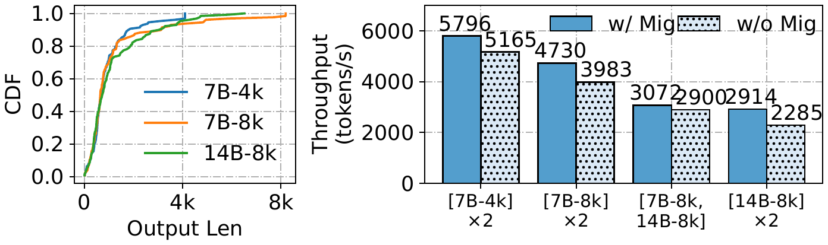
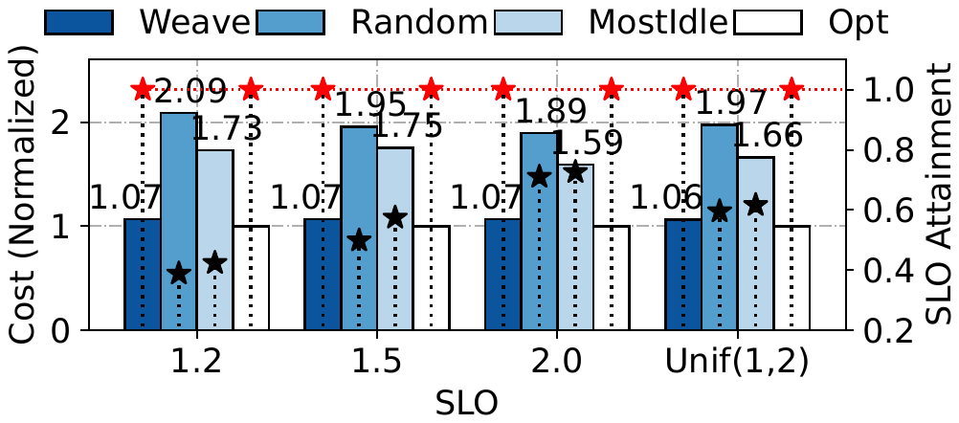
Evaluation: Scheduler and Runtime Ablations
Weave stays near optimal across workload mixes and turns runtime mechanisms into measurable throughput gains.
Inter-group scheduler optimality
Runtime gains
100% SLO attainment
1.06-1.28x migration gain
Scheduler cost tracks the offline optimum while runtime migration recovers tail slack.
Placement + runtime recover cluster bubbles.
26

Slide 27
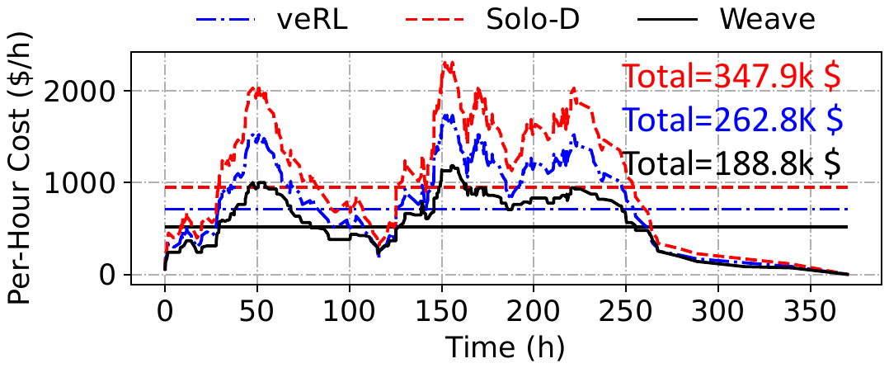
Production-Scale Trace Replay
On a two-week production workload, Weave reduces cost while preserving SLOs.
Per-hour cluster cost over time
Headline results
- 328 H20 GPUs for rollout.
- 328 H800 GPUs for training.
- Two-week production workload.
1.84x lower cost vs solo
1.38x lower cost vs veRL
100% SLO attainment
Long-tail bubbles are per-job; waste is avoidable across jobs.
27

Slide 28
05
RollArt ^{[OSDI ’26]}: Agentic RL
Disaggregate heterogeneous agentic pipelines and schedule at trajectory granularity.
Heterogeneous resources
Trajectory-level asynchrony
Production-scale agents
Gao et al., “RollArt: Disaggregated Multi-Task Agentic RL Training at Scale,” in OSDI ’26.
28

Slide 29
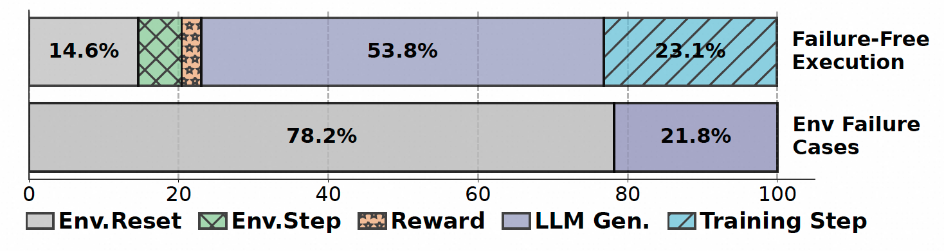
Agentic RL Is a Heterogeneous Pipeline
Multi-turn environments add CPU, GPU, reward, and synchronization work to every trajectory.
Agentic RL training loop
Four Heterogeneous Workloads
No single stage dominates
- LLM Generation [GPU]
- Environment Interaction [CPU/GPU]
- Reward Compute [CPU/GPU]
- Model Training [GPU]
Work shifts across all stages in agentic RL.
Agentic RL requires scheduling across stages, devices, and trajectories.
29

Slide 30
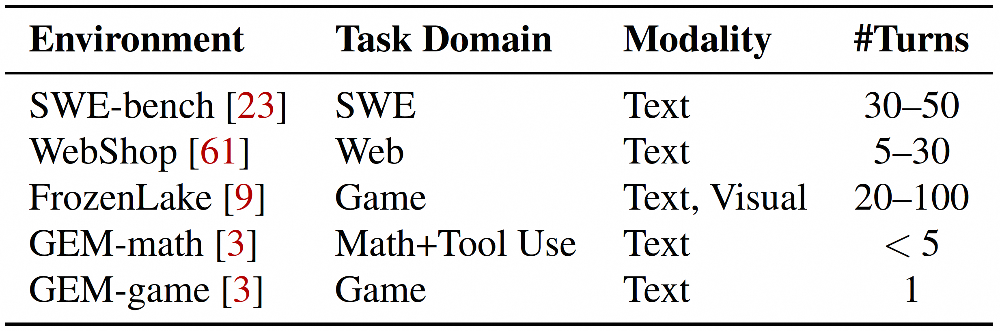
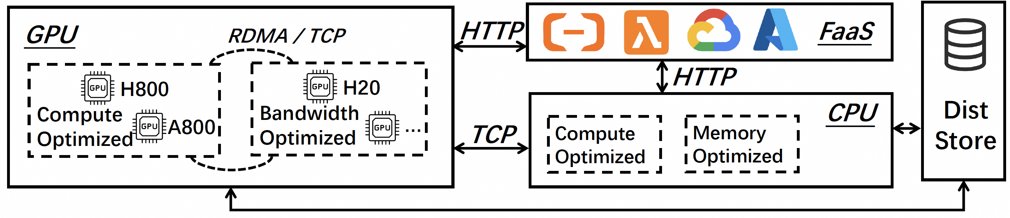
Why Disaggregate Agentic RL?
Environments and stages demand different resources, but disaggregation creates orchestration challenges.
Extreme environment diversity
Disaggregated infrastructure
- SWE, web, game, math, and tool-use environments expose different turn counts.
- Modalities and runtimes mix text, vision, I/O, and sandboxed code.
- GPU pools specialize for compute or bandwidth.
- CPU/serverless workers handle environments and reward.
- Distributed storage and RDMA/TCP become part of the critical path.
Better utilization requires placement and progress control.
30

Slide 31
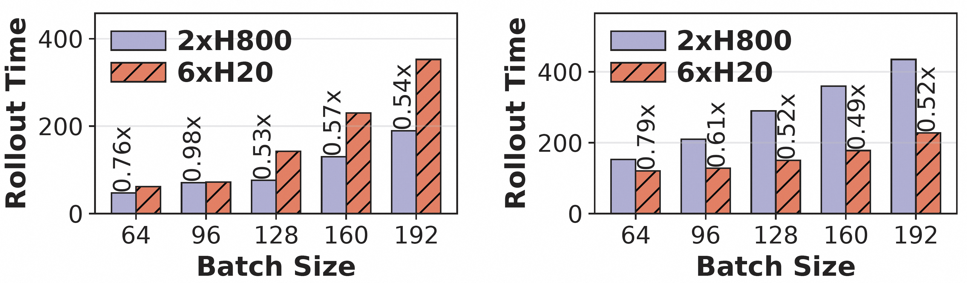
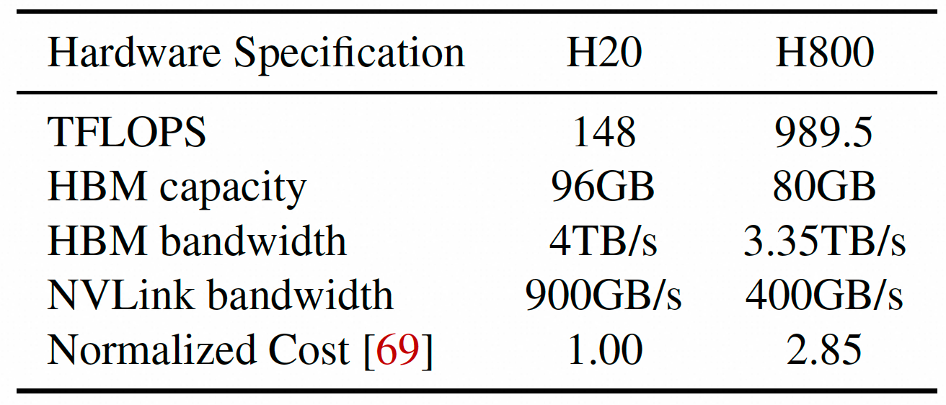
Generation Is Not Uniformly Bandwidth-Bound
The best GPU allocation depends on whether a task is prefill-heavy or decoding-heavy.
Task-aware GPU selection
H20 vs H800
- H800: high compute.
- H20: high memory capacity and lower normalized cost.
- Rollout mapping should depend on task shape.
Prefill-heavy: compute
Decode-heavy: bandwidth
Static GPU binding leaves performance on the table; task-aware selection improves rollout throughput.
R1: Agentic rollout needs heterogeneity-aware placement, not one fixed GPU type.
31

Slide 32
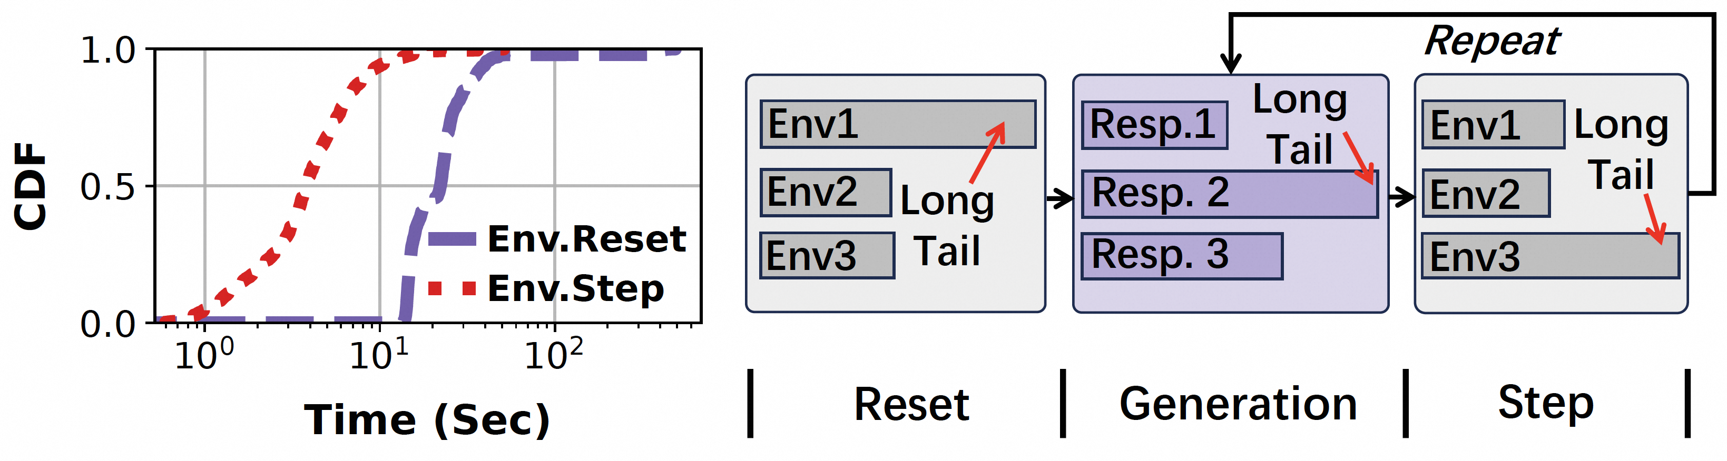
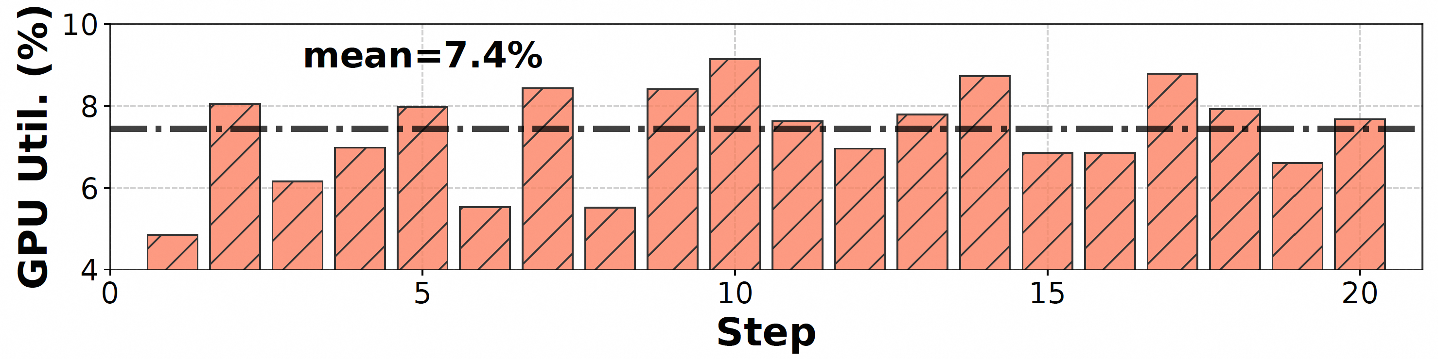
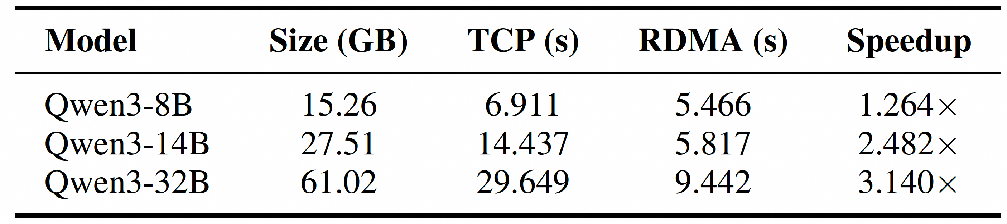
Agentic RL Adds New Long-Tail Sources
Environment calls, reward workers, and weight synchronization create stragglers beyond LLM generation.
Environment execution is heavy-tailed
Reward is lightweight
Mean GPU utilization is only 7.4%.
Batched interaction can inflate rollout time by up to 21.3%.
Weight synchronization is costly
Design implication
- R2: Manage progress per trajectory.
- R3: Offload stateless reward work.
- R4: Bound weight staleness instead of globally synchronizing every step.
32

Slide 33
RollArt: Three-Plane Design
Separate what to run, where to run it, and how trajectories make progress.
Three coordinated planes
Control Plane
LLM proxy, request scheduler, sample buffer, model-update coordination
R2/R4 rollout/train progress
Data Plane
environment cluster, action cluster, reward cluster, buffer cluster
R3 reward offload
Resource Plane
CPU nodes, serverless backend, H20/H800 GPU pools
R1 affinity mapping
Programming model hides distributed orchestration from users.
33

Slide 34
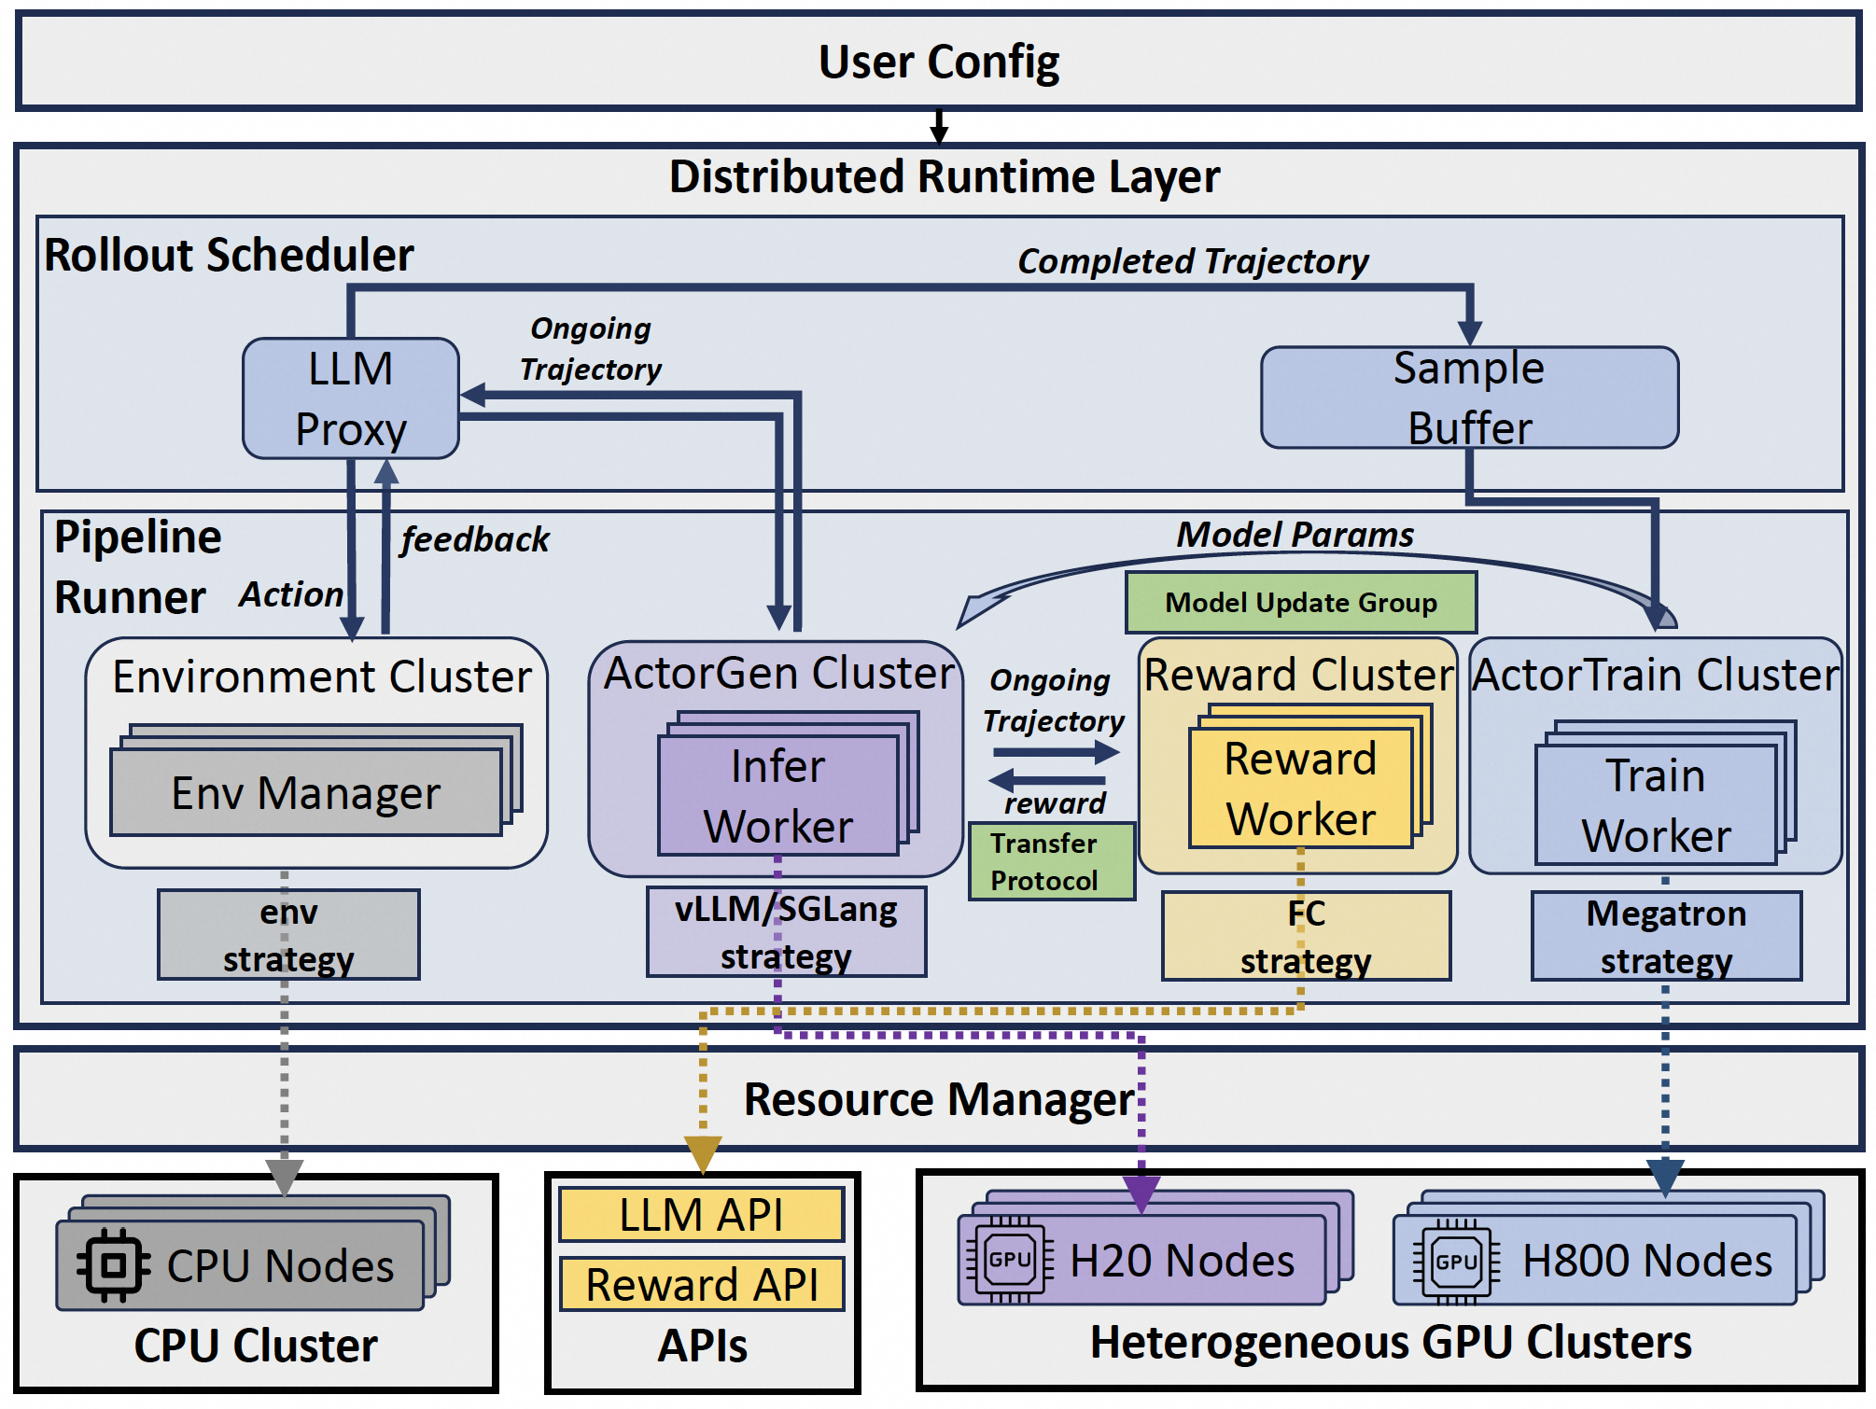
RollArt Architecture: End-to-End Workflow
Rollout, reward evaluation, and training proceed asynchronously over disaggregated resources.
Workflow over heterogeneous clusters
⑤ Buffer Completed
Trajectories
④ Interact via
LLMProxy
② Instantiate clusters
③ Launch
EnvManagers
① Bind heterogeneous
resources
Rollout, reward evaluation, and training proceed asynchronously
34

Slide 35
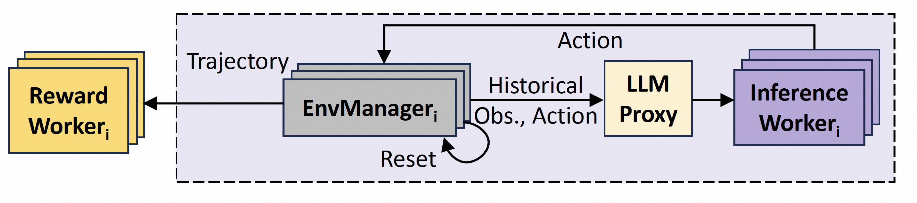
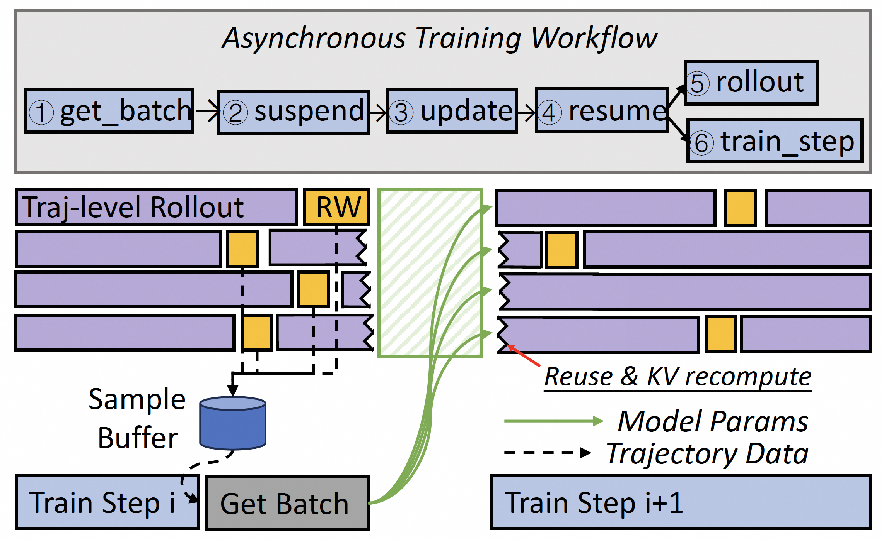
Trajectory-Level Asynchrony
RollArt decouples generation, environment interaction, reward, and training while bounding staleness.
Trajectory-level rollout
Fail-slow and fail-stop trajectories never block the rest of the batch.
Bounded asynchronous orchestration
Learning guardrail
- Per-trajectory staleness bound alpha.
- Buffer size O(alpha * E).
- alpha = 1 balances speed and stability.
35

Slide 36
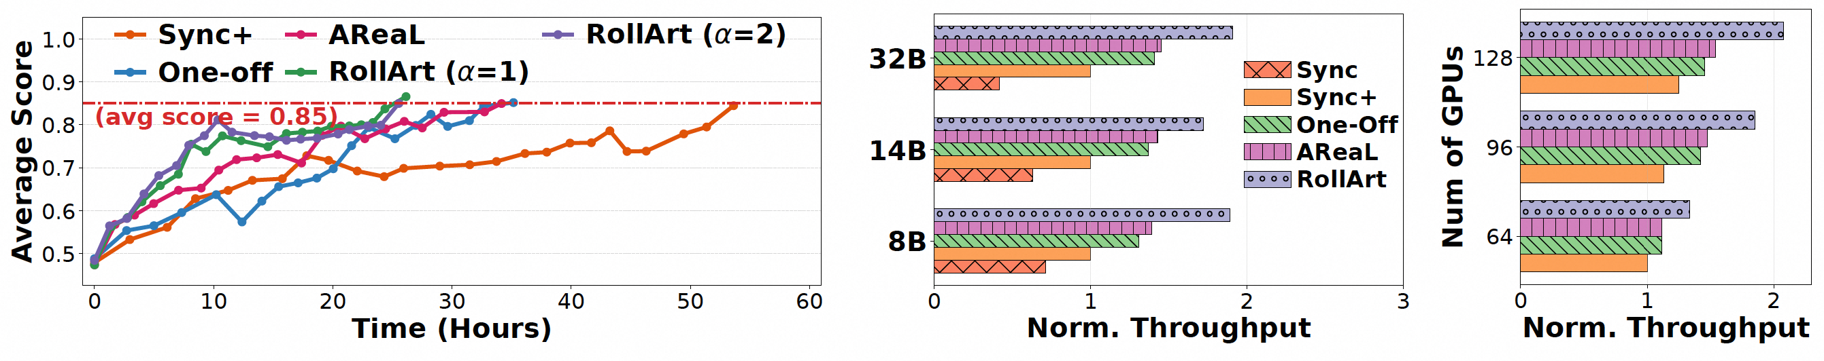
End-to-End Evaluation
RollArt improves convergence time and normalized throughput across model sizes and cluster scales.
Results across convergence, model size, and cluster scale
Faster convergence + throughput.
Setup
Baselines
Takeaway
Qwen3-8B to 32B; H800 + H20, 128 GPUs.
Sync, Sync+, One-Off, AReaL.
1.31-2.05x E2E time reduction.
36

Slide 37
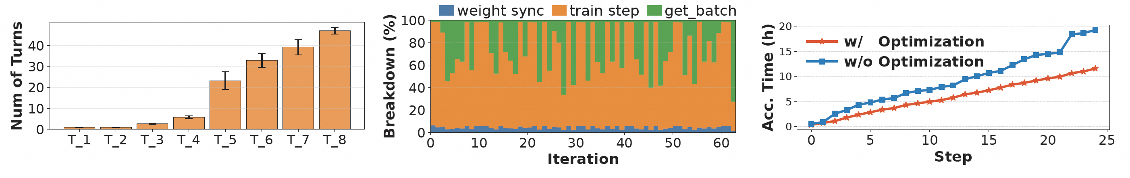
RollArt in Production
The same design scales to production-grade agentic RL on heterogeneous clusters.
Production deployment
Workload heterogeneity
At-scale optimization
- Agentic RL on 3000+ GPUs.
- Hundreds-of-billions-parameter MoE.
- Production multi-task environment mix.
- Max response length > 5x mean.
- Max environment turns > 40x mean.
1.67x E2E
Benefits hold in the wild.
Production evidence
37

Slide 38
06
Conclusion & Future Work
RL post-training keeps widening across tenants, agents, environments, and model families.
Multi-tenant
agentic RL
Evolving RL
paradigms
Agentic
infrastructure
38

Slide 39
Conclusion & Future Work: Taming the Long Tail Across Scopes
Long-tail stragglers are inevitable; idle accelerators are not.
A widening optimization scope: every bubble can become useful work.
Single Job
Multi-Tenant
Agentic RL
RollPacker
Weave
RollArt
Reorder long rollouts
while staying on-policy.
Co-schedule RLVR jobs
to fill dependency bubbles.
Disaggregate pipelines
and schedule trajectories.
RL Keeps Evolving : next systems frontier spans scheduling scope, RL tasks, and agentic infrastructure.
Multi-Tenant Agentic RL
Evolving RL Workloads
Agentic Infrastructure
Beyond RLVR
New compute shapes
Optimize the env layer
39

