Slide 1
Unlocking AI Inference: Mastering EP Load Balancing and Communication in Diverse AI Applications
Binzhang Fu
Alibaba Cloud

Slide 2
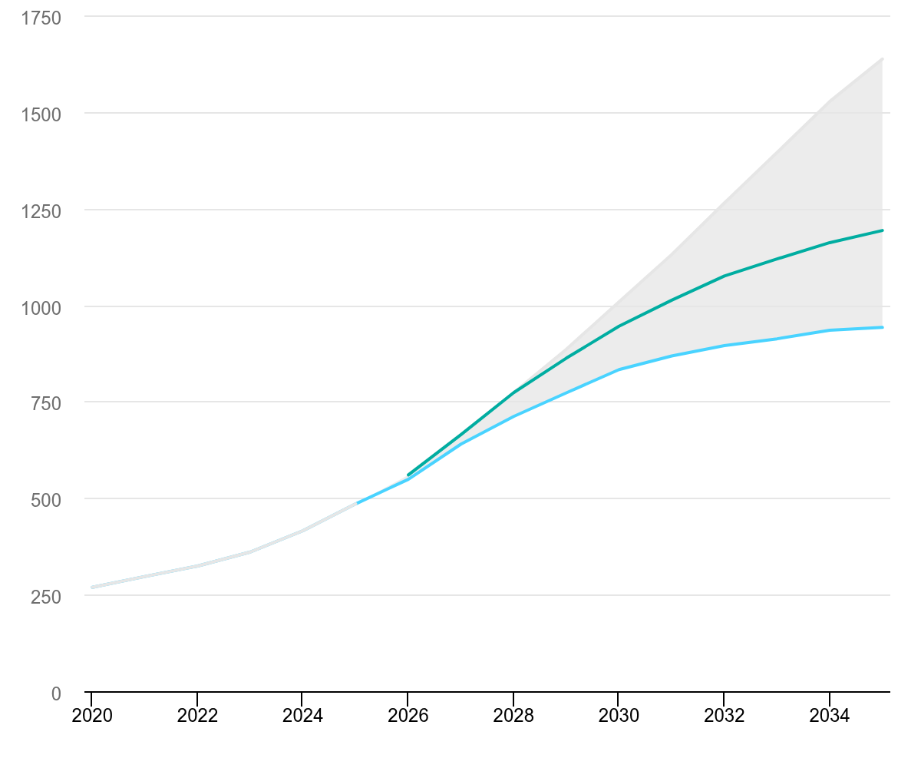
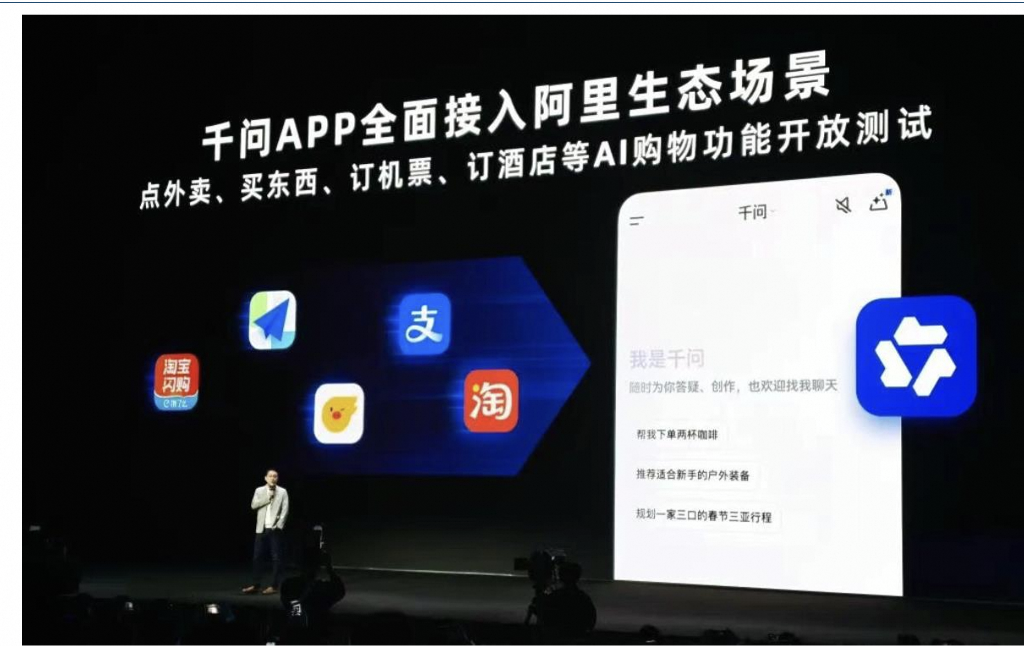
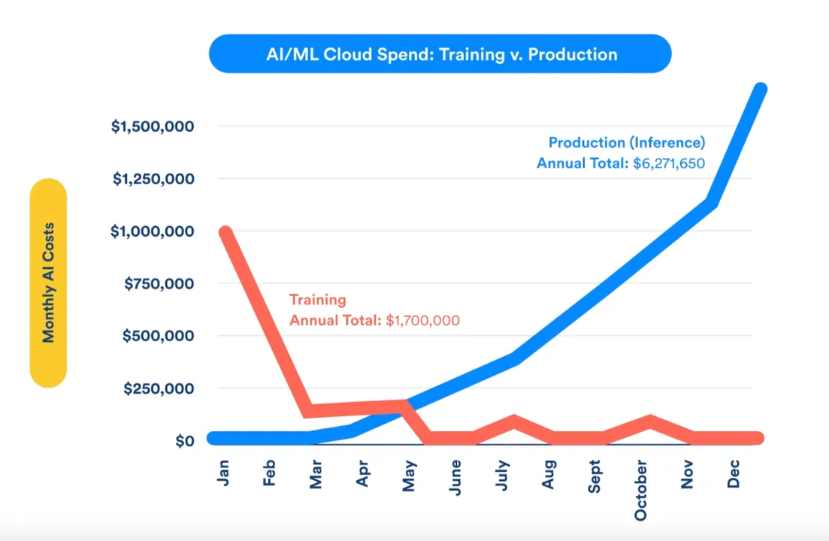
The LLM Renaissance
DC electricity consumption：
485 TWh in 2025 → 950 TWh in 2030
From chatbots to AI agents：
28.5M agents in 2025 → 2.2B in 2030 ^{note-1}
The 80/90 Rule：
Inference Dominates Compute Costs
IEA (2026), Electricity consumption by data centres, 2020-2035, IEA, Paris https://www.iea.org/data-and-statistics/charts/electricity-consumption-by-data-centres-2020-2035, Licence: CC BY 4.0
Qwen has fully integrated the Alibaba ecosystem and launched the Task Assistant to empower users with real-world execution capabilities.
The Real Price of AI: Pre-Training Vs. Inference Costs，https://www.ankursnewsletter.com/p/the-real-price-of-ai-pre-training
Note-1: IDC：未来5年全球活跃Agent数据将呈现爆发式增长, https://www.163.com/dy/article/KJ2Q5G3205198UNI.html

Slide 3

The LLM Inference Pipeline: Performance & Cost Breakdown
LLM Inference Engine (Prefill + Decode)
Prefill Phase Zone
Decode Loop
PREFILL
(ENCODING PROMPT)
Full input in one go
DECODE LOOP
(TOKEN GENERATION)
CLIENT
(USER APP)
API
GATEWAY
CACHE AWARE SCHEDULING
BATCH &
TOKENIZER
DETOKENIZER
KV STORE
（Prefix matching）
Loop x N
times
KV CACHE
（memorized attention）
STREAMING RESPONSE
Generate tokens one by one
Latency < 1%
Cost < 1%
Latency 1-3% Cost 1-3%
Latency 1-5%
Cost <1%
Latency 1-3%
Cost 1-3%
Latency 1-3%
Cost 1-3%
Latency 2-30%
Cost 2-5%
Latency 10-70%
Cost 20-60%
Latency 35-70%
Cost 40-60%
Streaming output
throughput speed
Time to First Token (TTFT)
Time per Output Token (TPOT)
DOMINIATED BY PREFILL, Perceived wait time
DOMINATED BY DECODE, Gap between successive tokens
x N tokens

Slide 4
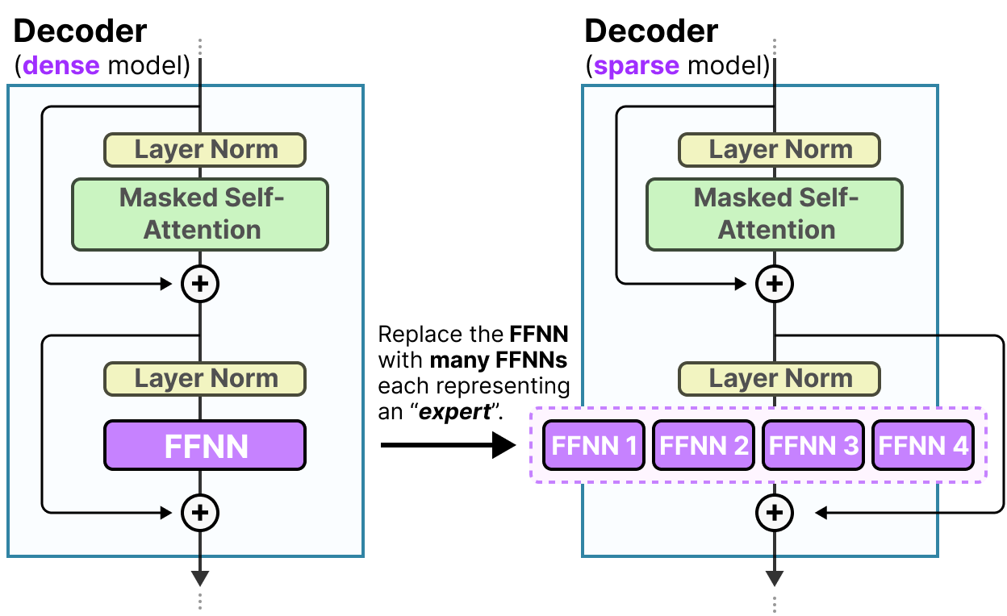
The Rise of Sparse Mixture-of-Experts (MoE)
MoE architecture delivers superior performance across computation, scalability, and efficiency dimensions.
The sparse activation paradigm enables trillion-parameter knowledge capacity while maintaining inference costs comparable to models 10x smaller, fundamentally changing the economics of large-scale AI deployment.
Model Name | Organization | Release Date | Total Params | Active Params | Architecture
Qwen 3.5 (397B-MoE) | Alibaba Qwen | Feb 2026 | 397B | 17B | MoE
Qwen 3.6 (35B-A3B) | Alibaba Qwen | Apr 2026 | 35B | 3B | MoE
DeepSeek V4-Pro | DeepSeek | Apr 2026 | 1.6T | 49B | MoE
DeepSeek V4-Flash | DeepSeek | Apr 2026 | 284B | 13B | MoE
Mistral Small 4 | Mistral AI | Mar 2026 | 119B | ~6B | MoE
Gemma 4 (26B MoE) | Google DeepMind | Apr 2026 | 26B | 3.8B | MoE
GLM-5.1 | Zhipu AI | Apr 2026 | 754B | ~32B | MoE
Figure source: https://newsletter.maartengrootendorst.com/p/a-visual-guide-to-mixture-of-experts
The leading open-source LLMs in 2026 have all adopted the MoE architecture.

Slide 5
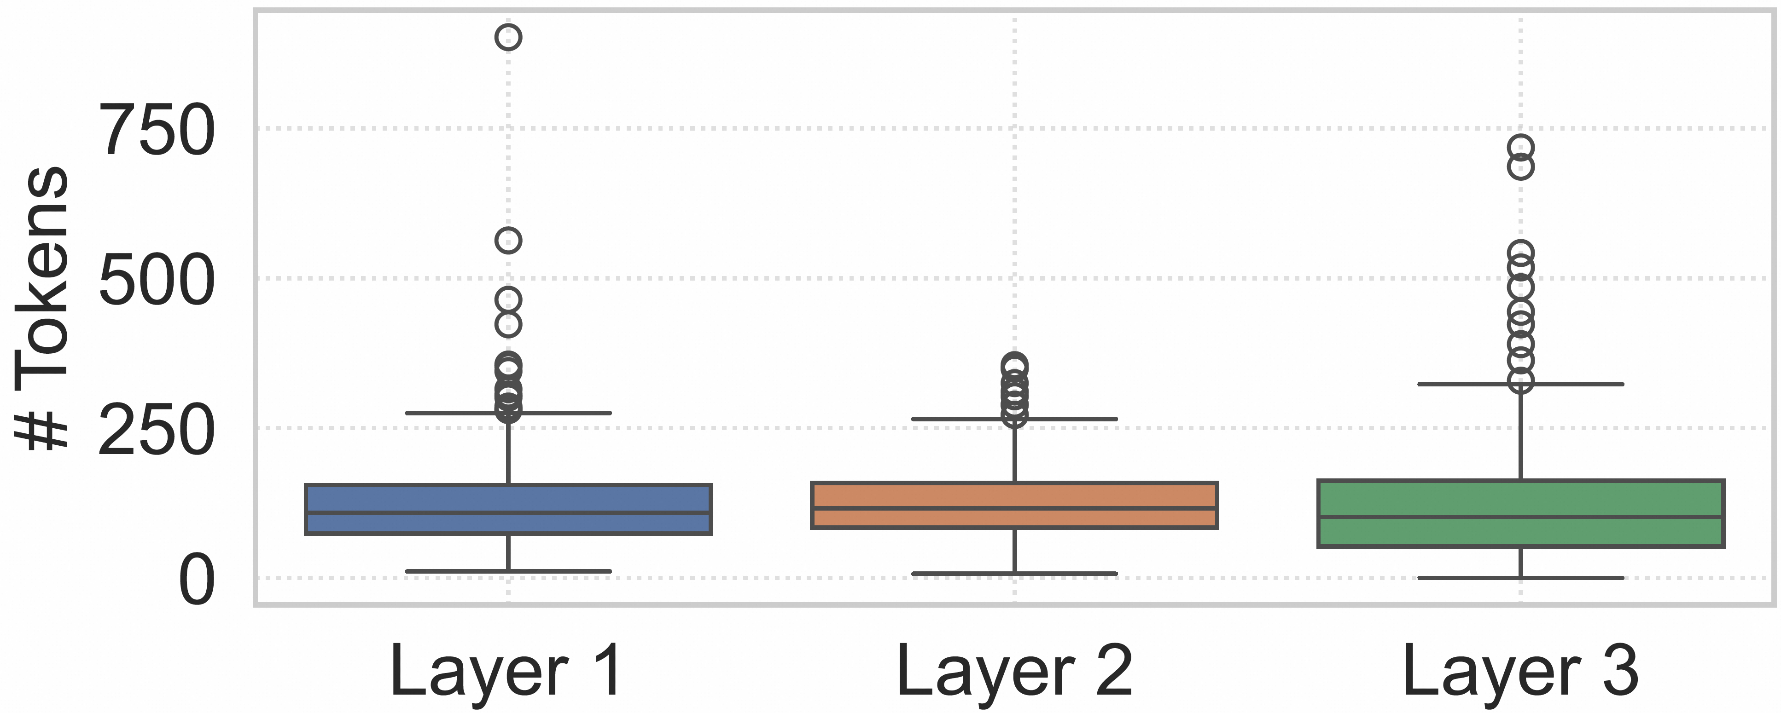
Bottlenecks in Expert Parallelism
Expert workload distribution in sampled layers
(DeepSeek-R1)
Challenge-1: Expert workload imbalance.
Above figure shows a sampled decode step across three layers, plotting tokens received per expert. In all three, loads vary widely, with the busiest expert receiving 74 times the layer average.

Slide 6
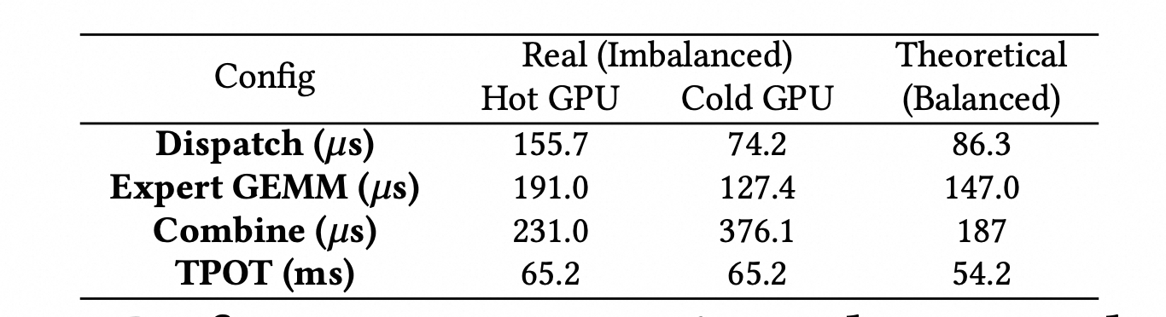
Bottlenecks in Expert Parallelism
Table 1. Performance comparison between balanced(theoretically-optimal) and imbalanced (real) gating.
(DeepSeek-R1, unoptimized; EP16 on 16×H20)
Challenge-1: Expert workload imbalance.
Compared to a balanced routing baseline, real skew increases dispatch+combine from 233.3 to 346.7 𝜇s and expert compute from 187 to 231 𝜇s, raising TPOT from 54.2 to 65.2 ms..

Slide 7
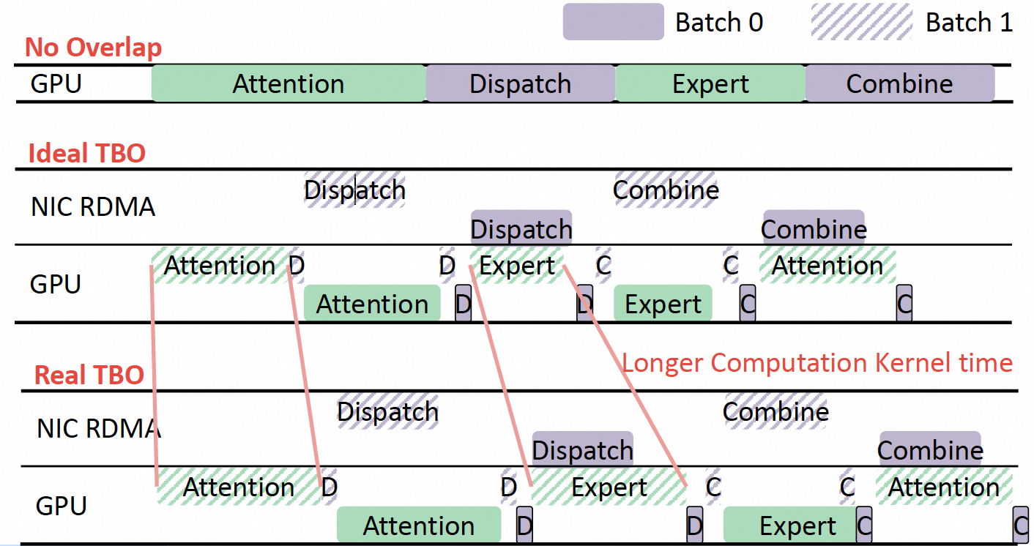
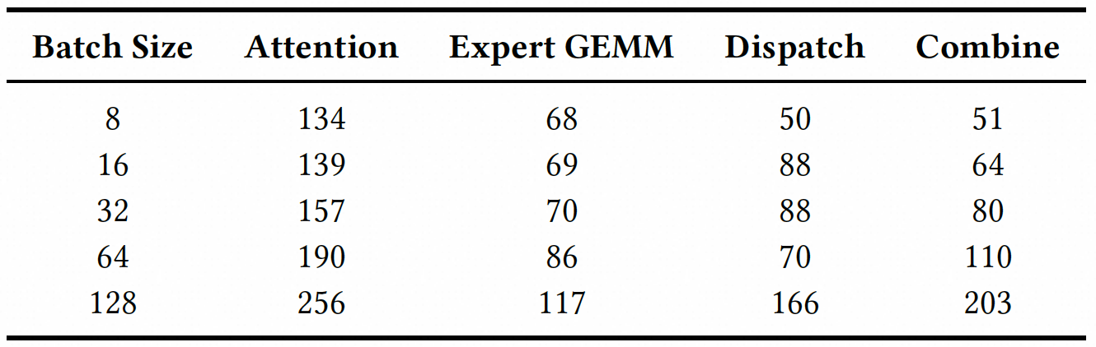
Bottlenecks in Expert Parallelism
190 >> 256/2
86 >> 117/2
Due to the overhead of memory access and control logic, the computation and communication costs do not scale down linearly as the batch size decreases. Blindly reducing the batch size leads to lower computational intensity and throughput efficiency, resulting in diminishing returns that outweigh the benefits.
Challenge-2: TBO does not perform well under small batch size scenarios.
Above example shows that splitting a batch of 16 into two 8s can nearly double total compute time, adding 169𝜇s of computation and 50𝜇s of communication, which is larger than the theoretical overlap ceiling (i.e., total communication time, 202𝜇s), so TBO yields a slowdown.
In our production environment, TBO hardly provide benefits since the batch is usually small (e.g., ≤128) under tight SLOs.

Slide 8
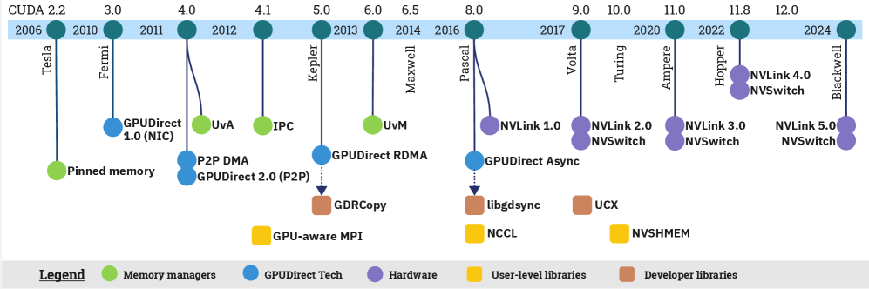
Bottlenecks in Expert Parallelism
Challenge-3: GPU-centric communication is very complicated.
Inter-node communication (scale-out): RDMA, GPUDirect RDMA, GPUDirect Async (IBGDA )
Intra-node communication (scale-up): SM (load/store), TMA, Copy Engine
Figure source: Unat, D., Turimbetov, I., Issa, M.K., Saugbili, D., Vella, F., Sensi, D.D., & Ismayilov, I. (2024). The Landscape of GPU-Centric Communication. ACM Computing Surveys.

Slide 9
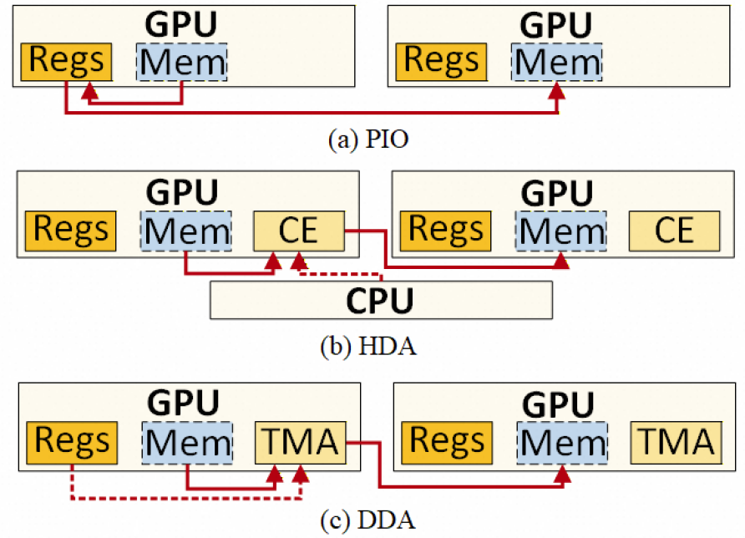
Bottlenecks in Expert Parallelism
Programmed I/O (PIO). GPU SMs explicitly issue concurrent data I/O instructions like Load and Store to transfer data between GPU memory spaces. The data will be delivered from SM registers and LSU to NVLink via on-chip network.
Host-driven DMA (HDA). Host CPUs initiate asynchronous data transfers via the GPU copy engine, which executes copy operations implicitly and without ongoing GPU SM involvement.
Device-driven DMA (DDA). GPU SMs initiate transfers through TMA instructions, after which the TMA engine executes data movement asynchronously. It is worth noting that DDA can consume SMs for temporary instruction issuance, but it avoids persistent register occupation during transmission.
Challenge-3: GPU-centric communication is very complicated.
Especially in scale-up networks, data transmission still has vast room for optimization, as most software engineers are not fully familiar with the underlying complex transfer mechanisms.

Slide 10
Our Solutions
Challenge-1: Expert workload imbalance.
Optimization-1: Per-step EPLB
Optimization-2: Token drop
Challenge-2: TBO does not perform well under small batch size scenarios.
Optimization-3: Per-expert overlap
Challenge-3: GPU-centric communication is very complicated.
Optimization-4: A set of communication optimizations for scale-up networks

Slide 11
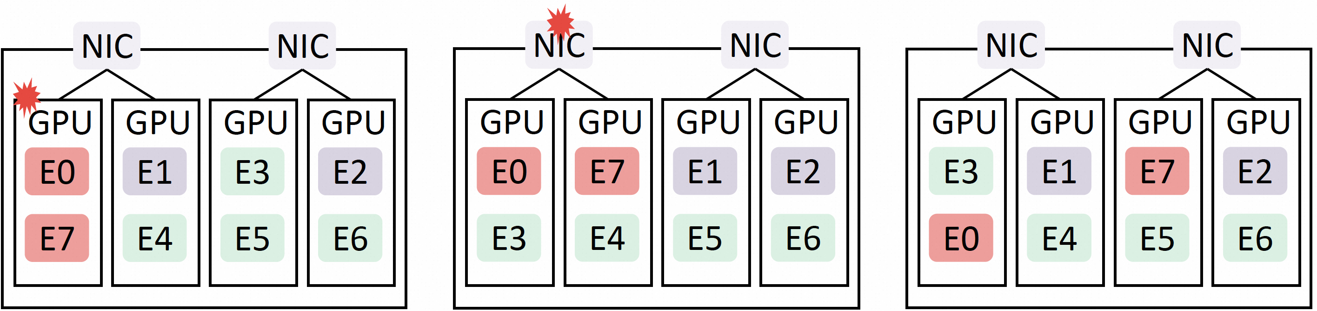
Our Solutions
Compute Imbalance
Communication Imbalance
After load balance
Optimization-1: Per-step EPLB.
We perform rebalance immediately after gating and fuse it into a single kernel with dispatch communication.
Unlike the original EPLB, our approach accounts for both compute and communication imbalances, delivering extra gains in bandwidth-constrained scenarios.
In production across EP8–EP64 deployments of open-source models such as DeepSeek-R1 and Qwen-Coder, our imbalance-oriented mechanisms reduce the imbalance ratio by about 40% versus naive EPLB and cut TPOT by 10–18%.
Currently, per-step expert swapping is only supported within the scale-up domain, as its sufficiently high bandwidth can significantly reduce expert swap overhead.

Slide 12
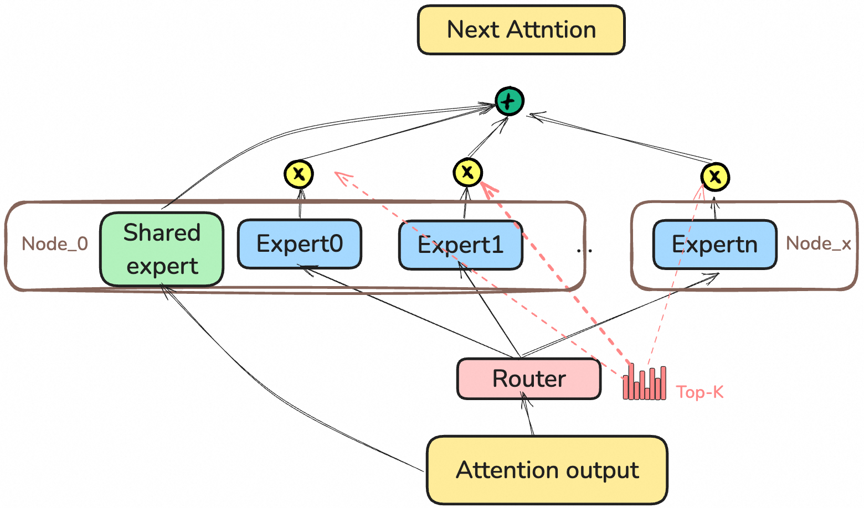
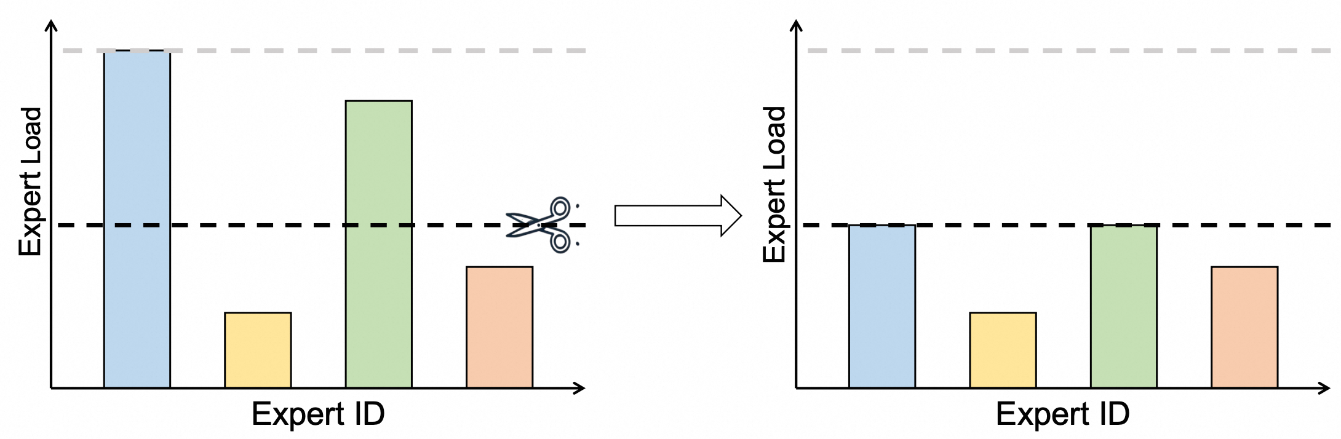
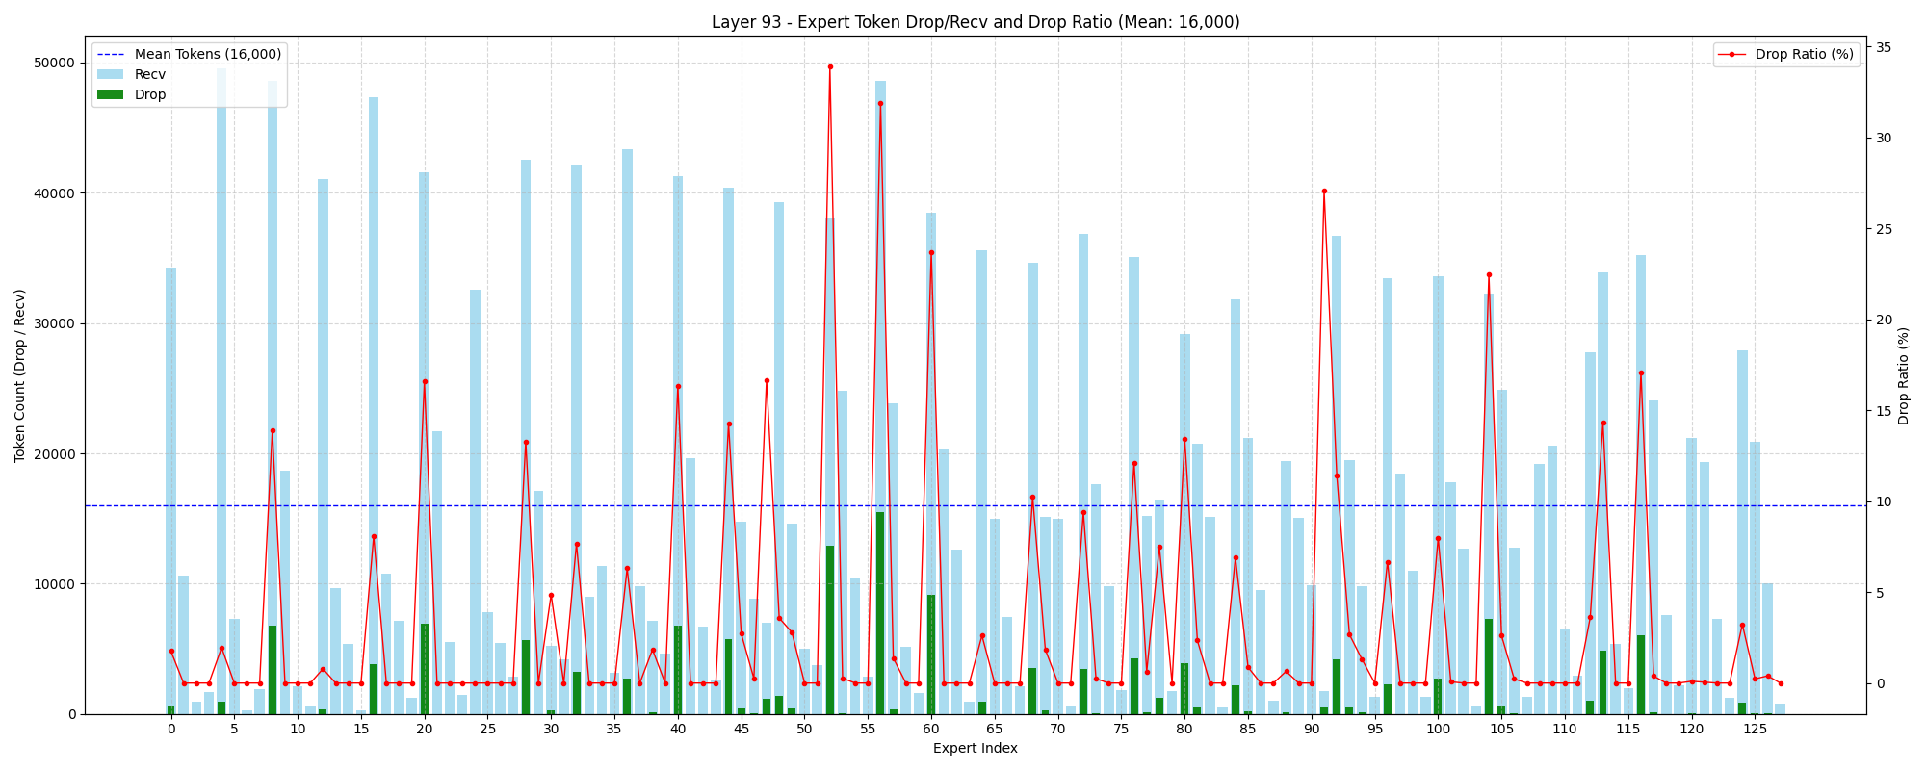
Our Solutions
Least weighted token drop
Optimization-2: Token drop.
Observation: Dropping low-weight tokens (skipping their computation) yields negligible differences in the final inference outcomes.
At the Qwen3-Coder-480B TP1EP32 GBS2048 workload, we achieved a 20% reduction in end-to-end latency.

Slide 13
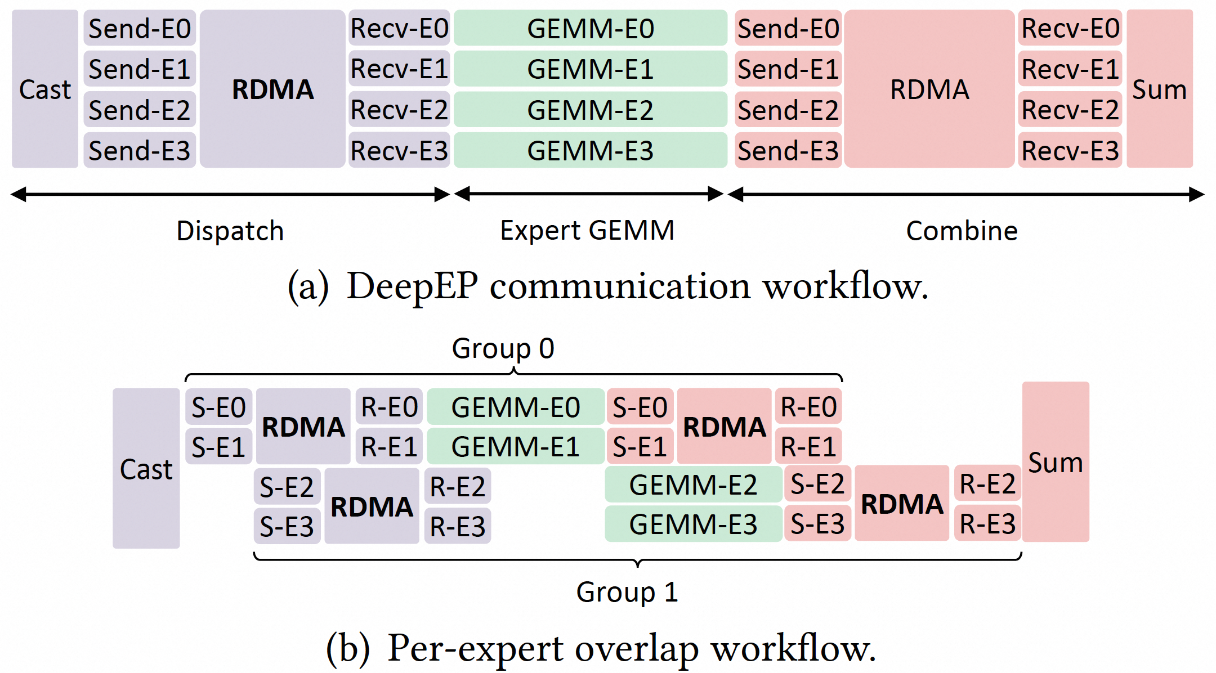
Our Solutions
Optimization-3: Per-expert overlap.
Observation: experts have no inter-dependencies after gating: each expert processes its own tokens independently.
Leveraging this independence, PEO (Per-expert-overlap) partitions each GPU’s local experts into multiple groups and pipelines dispatch, compute, and combine at the granularity of groups.
Across groups, we stagger these stages to form a pipeline, allowing different groups to occupy different phases concurrently while enforcing minimal dependencies to prevent NIC and SM contention.
For batch size ≤ 128, PEO consistently lowers TPOT by 0.9–17.6% and 1.8–8.3% compared to TBO and Non-Overlap, respectively.

Slide 14
Our Solutions
OPTIMIZATIONS |  |  | DeepEP | HybridEP | AcclEP
LOW LATENCY | Dispatch | Avoid synchronization | ❌ | ❌ (N/A) | ✅
 |  | TMA enabled | ❌ |  | ❌ （N/A, ll128-based algorithm）
 | Combine | Avoid synchronization | ❌ |  | ✅
 |  | TMA enabled | ✅ |  | ✅
NORMAL （intra node） | Dispatch | Avoid register spills | ❌ | ❌ | ✅
 |  | TMA enabled | ✅ | ✅ | ✅
 |  | Zero copy | ❌ | ❌ | ✅
 | Combine | Avoid register spills | ❌ | ❌ | ✅
 |  | TMA enabled | ✅ | ✅ | ✅
 |  | Zero copy | ❌ | ❌ | ✅
Note: DeepEP LL kernel’s commit-id is b57e5e2, DeepEP normal kernel’s commit-id is 1b14ad6, HybridEP’s commit-id is 83e0d15
Optimization-4: A set of communication optimizations for scale-up networks
For ll kernel (per-rank tokens=128, hidden-size=7168), we achieved a 7.7%–24.6% performance boost across EP4 to EP64.
For the normal kernel (per-rank tokens=4096, hidden-size=7168, BF16, 32SM), performance gains reached 8.8%–123.4% across the same EP scales.

Slide 15
Key Takeaways
#1: CCLs should cross boundaries and integrate tightly with compute.
#2: There is no ‘silver bullet’ that works for all workloads. Given the rapid evolution of model architectures, optimizing inference performance remains highly resource-intensive.
#3: Ample optimization opportunities remain for fully exploiting hardware capabilities.

Slide 16
THANKS

