Slide 1
Rethinking AI for Network Security:
Solving Architectural Rigidity
Before Building Foundation Models
Dinil Mon Divakaran
Safety and Security, A*STAR IAIC
APNet 2026

Slide 2
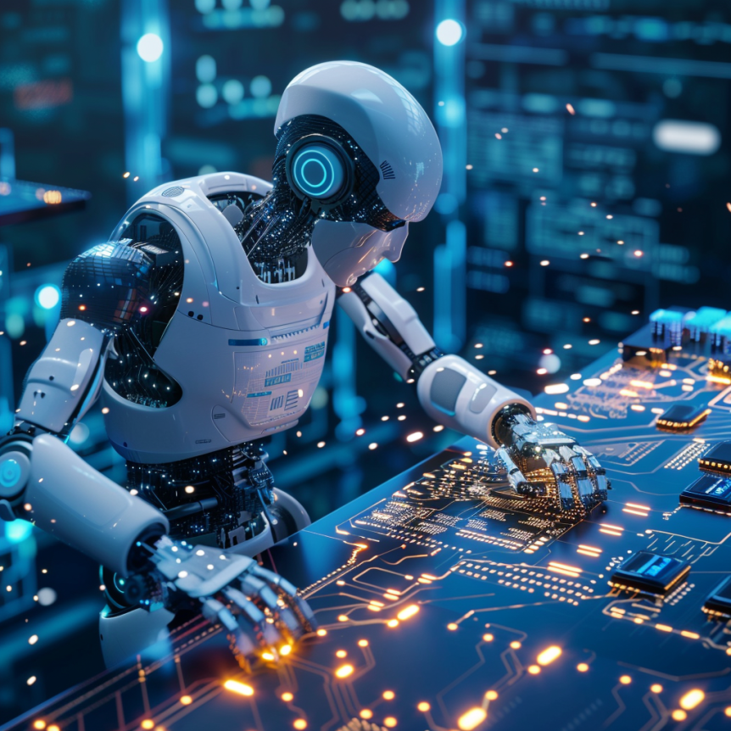
AI x Security
Network Security
Phishing/Scam Detection
Darkweb Threat Intel Gathering & Analysis
Reverse Engineering of Binaries
Security of AI

Slide 3
Why AI-based Network Traffic Modeling (for S&P)?
Networks: 5G/Telco, Datacenter, Enterprise, & Consumer
Traffic → mostly encrypted
  Payloads in particular
  Rules → utility limited
Even DNS (DoH/DoQ/DoT ..)
Problems, two dimensions:
Security of n/w: Malicious? What attacks? ..
Privacy of users: Identify users, devices, websites, etc.

Slide 4
Solving Architectural Rigidity
Building Foundation Models
Before
Number of research works on building “foundation models”
Necessary? Sufficient?
Challenges
Data: from real networks, with no artifacts
“Traffic Modeling for Network Security and Privacy: Challenges Ahead,” AAAI Workshop on AI for Cyber Security, 2026
Deployability of model
Explainability
Representation capable to capture different traffic formats
Why we are here today ☺
“UniNet: A Unified Multi-Granular Traffic Modeling Framework for Network Security,” in IEEE Trans. on Cognitive Comms. and Networking, 2025

Slide 5
Network S&P: ML-based Traffic Analysis Tasks
Encrypted Traffic Identification
Network Anomaly Detection and Attack Identification
And .. Token inference, Tor denonymization attack, in-network defense etc.
Website Fingerprinting
IoT Device Identification
Levente Csikor, Himanshu Singh, Min Suk Kang, and Dinil Mon Divakaran, “Privacy of DNS-over-HTTPS: Requiem for a Dream?,” in IEEE EuroS&P, 2021
Ido Nevat, Dinil Mon Divakaran, Sai Ganesh Nagarajan, Pengfei Zhang, Su Le, Ko Li Ling, and Vrizlynn Thing, “Anomaly Detection and Attribution in Networks with Temporally Correlated Traffic,” IEEE/ACM Transactions on Networking, 2018
Kushan S. K. Liyanage, Dinil Mon Divakaran, Rhishi Pratap Singh, and Mohan Gurusamy, “ADEPT: Detection and Identification of Correlated Attack-Stages in IoT Networks,” IEEE Internet of Things Journal, 2021
Akshaye Shenoi, Prasanna Karthik, Kanav Sabharwal, Li Jialin, and Dinil Mon Divakaran, “iPET: Privacy Enhancing Traffic Perturbations for Secure IoT Communications,” in PETS 2023
Xin Zhe Khooi, Levente Csikor, Dinil Mon Divakaran, and Min Suk Kang, “DIDA: distributed In-Network defense architecture against amplified reflection DDoS attacks,” in IEEE NetSoft, June 2020
Binghui Wu, Dinil Mon Divakaran, Levente Csikor, Mohan Gurusamy, “RECTor: Robust and Efficient Correlation Attack on Tor,” IEEE Commn. Magazine, 2025
Levente Csikor, Ziyue Lian, Haoran Zhang, Nitya Lakshmanan, and Dinil Mon Divakaran, “DNS-over-QUIC and HTTP/3 in the era of transformers: The new Internet privacy battle,” IEEE Commn. Magazine, 2025

Slide 6
NetS&P research problems: past, present, future
Network Anomaly Detection
  Attack Classification
IoT device fingerprinting: identifying IoT devices in a network
Analysis of encrypted DNS for privacy leaks (website fingerprinting)
  DoH, DoQ, etc.
Tor node correlation: Attack to correlate flow at entry and exit nodes
Multi-layer unified traffic modeling using Transformers:
  session → flows → packets

Slide 7
What do we mean by Traffic Representation?

Slide 8


Traffic – Session – Flow (illustration)
Session
…..
DNS Flow
…..
HTTP Flow 1
…..
HTTP Flow 2
TCP/UDP Session → flows of packets
Client Application
Server Application
5-tuple Flow
Source IP Address
Destination IP Address
Source Port Number
Destination Port Number
Transport Layer Protocol

Slide 9
Information from Packets and 5-tuple Flows
Version
Protocol
IP Header
Source IP Address
Destination IP Address
Source Port Number
Destination Port Number
Transport Layer Protocol
Source IP Address
Destination IP Address
TCP/UDP Header
Source Port
Destination Port
Payload
Data - mostly encrypted
5-tuple Flow
Meta information: Packet size; Inter-packet arrival time
key
Client port
Transport layer protocol
Direction
Inter-arrival time
Packet size
Service port/app
Per-packet features
443 (HTTPS)
-1 (random)
6 (TCP)
1
0.154
54
aggregate
value
/
: Continuous
Flow
Duration
average
inter-arrival time
Flow size
(packet count)
average
packet size
TCP flags
combination
std
packet size
Flow features
/
: Category
102
0.174
584
84
10 (SYN+ACK )
…
10.3

Slide 10
Traffic Representation: Do’s and DoNot’s
Traffic Feature | Guideline | Reasoning | Recommended Encoding Strategy
Meta Information Packet Size, Direction, IAT |  | Depends on network characteristics | Extract statistical moments (Min, Max, Mean, StdDev)
IP Addresses IPv4 / IPv6 Hosts |  | Overfitting | Identify and encode as “server”, “client” or “peer”
Application Ports Well-Known Ports (< 1024) |  | Direct indicator of application service class & intent | Encode as One-Hot vectors or discrete categorical embeddings
Ephemeral Ports Dynamic Client Ports (> 1024) |  | Noise from random OS port assignment | Replace with a simple binary flag is_ephemeral or ignore
Encrypted Payload TLS Ciphertext Payload |  | Learning randomness? | Model TLS Handshake metadata (SNI, Cipher Suites) & sequence dynamics

Slide 11


Traffic – Session – Flow (illustration revisited)
Sessions
packets localized by time, grouped by same src IP
Session
…..
in other words, comprises of multiple flows
…..
Question
How would a model learn the characteristics of a session?
DNS Flow
…..
5-tuple flows
HTTP Flow 1
…..
HTTP Flow 2

Slide 12
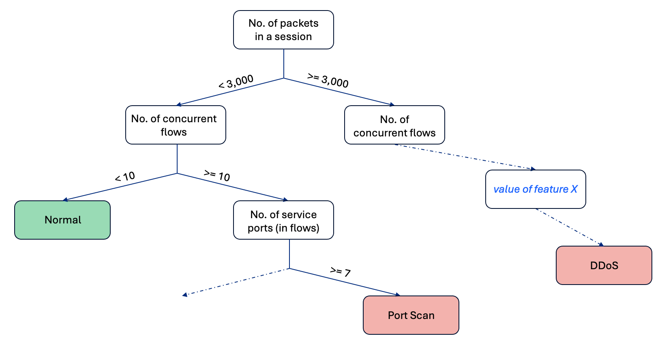
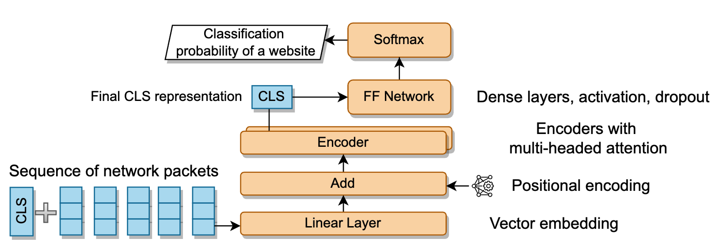
Learning Characteristics of Traffic Sessions
Traditional ML, e.g., Decision Tree:
Engineer features – to have scalable representations
Engineered features:
Per Session: no. of Flows, no. of services, no. of TCP Flows, Flow size stats, Flow rate stats, etc.
Per Flow: Flow rate, Flow size, Packet size stats (mean/std/min/max/..), Inter arrival pkt-time stats, etc.
Era of Transformers
With the rise of sequence models (Transformers), sequences of 100s/1000s of packets provided as input
Raw / Fundamental features:
Per-packet features: service app/port, direction (server to client or back), packet size, inter-arrival time, TCP/UDP, etc.

Slide 13














UniNet: Unified Multi-granular Traffic Modeling Framework
Packet
Flow
Latent embedding
Tokenization
Segmentation
Multi-class Device Identification
…
…
Session
T-Matrix
Semantic feature extraction
T-Attent
Anomaly Detection
next flow
Sessions
0
1
1
0
1
1
0
1
1
Relative Segmentation
…
Flows
…
…
Flow only
Packets
…
…
…
…
Packet only

Slide 14
UniNet: Unified Multi-granular Traffic Modeling Framework
Packet
Flow
Latent embedding
Tokenization
Segmentation
Multi-class Device Identification
…
…
Session
T-Matrix
Semantic feature extraction
T-Attent
Anomaly Detection
next flow
Sessions
Relative Segmentation
0
1
1
0
1
1
0
1
1
…
…
Flows
…
Flow only
Packets
…
…
…
…
Packet only

Slide 15
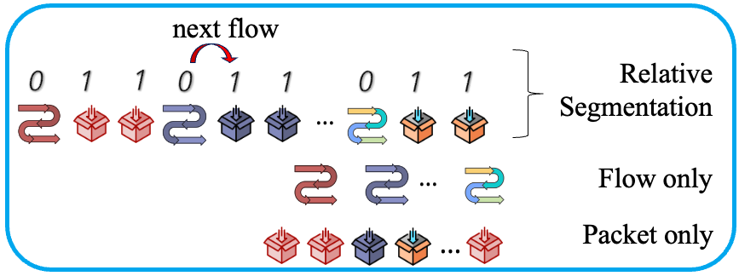
UniNet: Unified Multi-granular Traffic Modeling Framework
Latent embedding
Tokenization
Segmentation
Multi-class Device Identification
…
…
T-Matrix
T-Attent
Anomaly Detection
Sessions
Flows
…
Packets
…
…
…
Semantic feature extraction

Slide 16
T-Matrix multi-granular traffic representation
Flow-level
Per-packet
Duration
Average
Inter-arrival time
Packet count
Average
packet size
TCP flags
combination
Source port
Destination port
Transport
layer protocol
Direction
Inter-arrival
time
Packet size
102
0.174
584
84
...
10 (SYN+ACK)
80
-1 (12,369)
6
1
0.154
54
Session
Flow 1
Packet1
...
Packet2
Flow n
Packet1
...
Packet2
...
Number of
src IP
Number of
dst IP
Total port
number
Average flow
duration
Average flow
size
Session-level
8
10
7
426
...
521

Slide 17


T-Attent Architecture
[MASK]
[MASK]
[MASK]
MFP head
Unsupervised Learning
Latent embedding
Encoders
Segment embedding
0
1
1
1
0
1
1
1
0
1
1
1
Positional embedding
1
2
3
4
5
6
7
8
9
10
11
12
Feature embedding
T-Matrix
[MASK]
[MASK]
[MASK]

Slide 18







Training Task-Specific Heads
Unsupervised
Semi-supervised
Supervised
MFP (Masked Feature Prediction) Head
Anomaly Detection Head
Classification Head
For self-supervised traffic representation learning without manual annotations.
AE-based head estimating boundary between normal and anomaly
MLP for multi-class classification tasks (attacks, IoT devices, website fingerprinting).
Masking Mechanism: Randomly masks a ratio of features in sequence with [MASK] tokens
Benign Training: Trained exclusively on benign traffic to build a normal reconstruction profile.
Architecture: Two fully-connected FC layers with ReLU activations mapped to a Softmax layer.
Contextual Learning: Model predicts true token IDs based on surrounding multi-granular context.
Decision Boundary: Sets threshold at the nth percentile of normal reconstruction loss.
Mapping: Transforms latent embedding into probability distribution over target classes.
Takeaway: By replacing only lightweight head while keeping the core T-Attent encoder backbone intact, UniNet eliminates the need for separate models across diverse security tasks, significantly reducing deployment and training overhead.

Slide 19
Performance Evaluations

Slide 20
Network Security & Privacy Tasks for Evaluations
Anomaly Detection
  Learning Paradigm: Unsupervised
  Detect traffic that deviates from the normal
Attack Classification
  Learning Paradigm: Supervised
  Binary for detecting attacks, multi-class for identifying attacks
Four NetS&P tasks
Different baselines for different tasks
Three datasets used
IoT Device Identification
  Learning Paradigm: Unsupervised
  Multi-class classification, to identify IoT devices connected to a network
Website Fingerprinting
  Learning Paradigm: Supervised
  Multi-class, 100 monitored and 45,000 `unmonitored’ websites

Slide 21
Task: Website fingerprinting
Identify websites that a user visited, given traffic is encrypted
  No payload available
  Based on the latest transport protocol - QUIC
Privacy attack on users
Who is the attacker? Someone who can sniff the user’s traffic.
Two scenarios:
  Closed-world: identify one among n (say, 100) websites
  Open-world:
    n monitored and k >> n unmonitored
    Realistic scenario
Dataset:
  HTTP/3 and DoQ (DNS-over-QUIC) web sessions across four vantage points
    Includes 75,000+ unique websites
    500 monitored QUIC sites visited 1,280 times each
    Additional unmonitored sites visited 4 times each

Slide 22
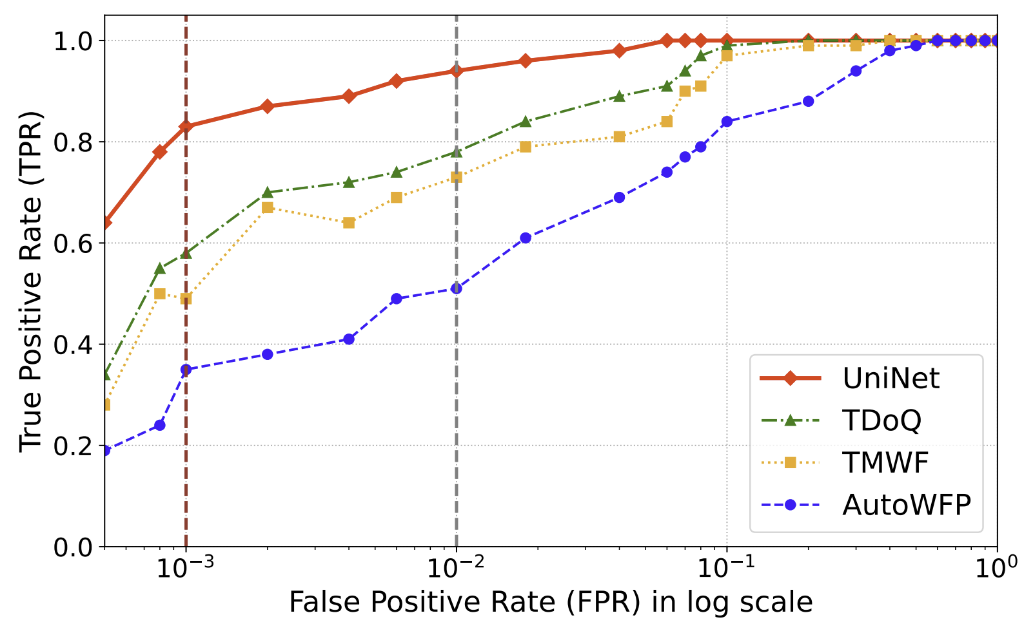
Results: Website fingerprinting
Baselines
  TDoQ and TMWF: Transformer based models, but using different architecture
  AutoWFP: LSTM-based model
Open-world scenario
Monitored: Top 100 QUIC-enabled domains, each generating 360 traces
Unmonitored: 45,000 other websites, each contributing four traces
No unmonitored website appears in both the training and test sets
References:
[TDoQ] Csikor, Levente, Ziyue Lian, Haoran Zhang, Nitya Lakshmanan, and Dinil Mon Divakaran. "DNS-over-QUIC and HTTP/3 in the era of transformers: The new Internet privacy battle." IEEE Commn. Magazine, 2025
[TMWF] Jin, Zhaoxin, Tianbo Lu, Shuang Luo, and Jiaze Shang. "Transformer-based model for multi-tab website fingerprinting attack," In ACM CCS, 2023.
[AutoWFP] Rimmer, Vera, Davy Preuveneers, Marc Juarez, Tom Van Goethem, and Wouter Joosen. "Automated website fingerprinting through deep learning," NDSS, 2017.

Slide 23
Conclusions
UniNet: a multi-granular traffic representation and learning framework
Works on packets, flows and sessions
Light-weight transformer architecture, with simple trainable heads for different tasks
Future directions:
  Explainability
  Robustness to adversarial attacks
  Capability to adapt to real-time streaming data
  Could potentially be taken as a framework for foundation model training?

Slide 24
Opportunities for Collaborations

Slide 25
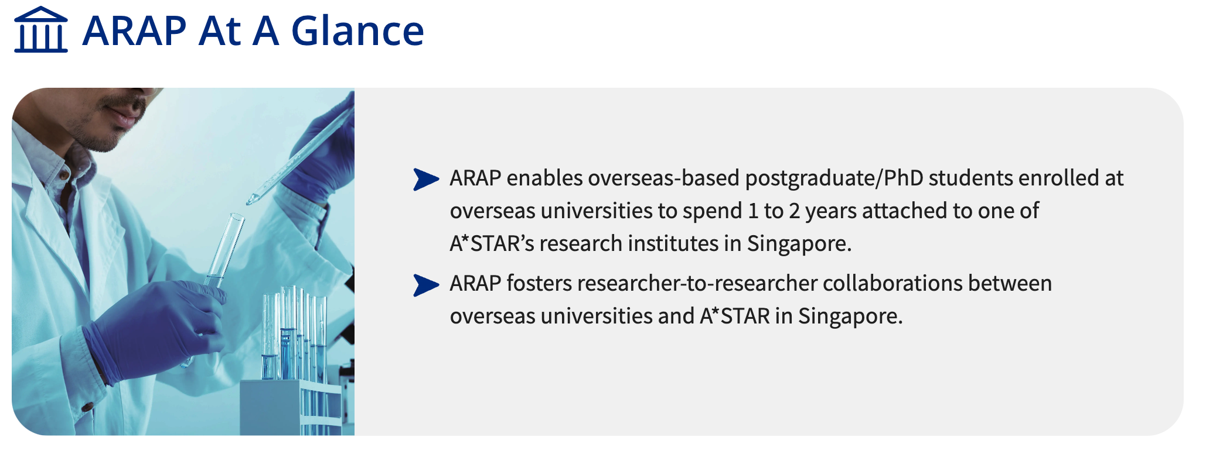
ARAP: A*STAR Research Attachment Programme

