Slide 1
Programmability in the
Switch Data-Plane
CHAN Mun Choon
School of Computing (SoC)
National University of Singapore (NUS)
APNet 2026 Keynote
Aug 6, 2026

Slide 2
Classic Notion of Network Devices
Hardware-based solutions with rigid and proprietary applications and devices
Minimum functionality assumed from the network (routers) is simply best-effort packet forwarding (internet’s minimalist mindset)
Problems:
  Evolves very slowly, difficult to change and innovate

Slide 3




































The legacy era…
CLI/custom script interface
--> Device/vendor specific
“Closed” Control Plane
ASIC APIs (closed)
Parser
VLAN
ACL
L2/MAC
L3
Deparser
Match-Action Pipeline

Slide 4
Towards more “programmability”
Open Signaling (1990s)
  Make network control functions more open, extensible, and programmable
  Separation between hardware and control software
  Access to the network hardware via open programmable network interfaces.
Focuses on connection-oriented network services in the early days
    IEEE P1520 (1998) programmable network interfaces
    IETF RFC3294 (2003) General Switch Management Protocol (GSMP)

Slide 5

2008-09: SDN Era (OpenFlow)
Open, vendor-agnostic interface:
→ Easier network management
→ Centralized control
→ Code reuse/interoperatibility
SDN –
Software Defined Networking
Control Plane
ASIC APIs (closed)
Parser
VLAN
ACL
L2/MAC
L3
Deparser
Match-Action Pipeline

Slide 6
2008-09: SDN Era (OpenFlow/SDN 1.0)
It didn’t change the core network functionality!
(Control plane became more programmable)
Open, vendor-agnostic interface:
→ Easier network management
→ Centralized control
→ Code reuse/interoperatibility
“Closed” Control Plane
ASIC APIs (closed)
Parser
VLAN
ACL
L2/MAC
L3
Deparser
Match-Action Pipeline

Slide 7

2013-14: Programmable Switches
Changing interface:
→ P4RunTime
→ C/Python APIs (auto-generated)
“Open” Control Plane
Protocol Independent
Switch Architecture (PISA) + P4
ASIC APIs
Programmable
Parser
Programmable
Deparser
Programmable Match-Action Pipeline

Slide 8
Benefits of Dataplane Programmability
Flexible Parsing and matching on non-standard fields:
  Faster and easier network evolution
    Hardware upgrades → software upgrades
H/w goes beyond this
  Expose additional datapath processing primitives (existing + new)
  Accessible and programmable via P4 (high-level DSL)
  Realize new capabilities (not fully arbitrary) in the datapath
    For existing/new problems and readily “realize” it in production hardware
What useful systems functions can we now move into the data plane?

Slide 9
Research on Programmable Network
Network Services:
Time synchronization (SOSR 2019)
In-network recovery (ICNP 2019, SIGCOMM 2023)
Networking Monitoring:
Design a “better” data structure for monitoring (CoNEXT 2020)
Build a “better” network debugger (APSys 2018, NSDI 2021)
Network Applications:
Datacenter - In-network load balancing (SIGCOMM 2023)
5G Network – Routing (Mobicom 2021), Acceleration (INFOCOM 2026)

Slide 10
Time Synchronization in Data Center (SOSR 2019)
NTP
milliseconds
PTP
10s of ns to us
Server
Server
CPU
CPU
Switch
CPU
NIC
PHY
PHY
NIC
PHY
PHY
Queues
Network Delays & Jitter affect accuracy!!
Clock Drifts upto 30µs/sec [HUYGENS ’18]

Slide 11
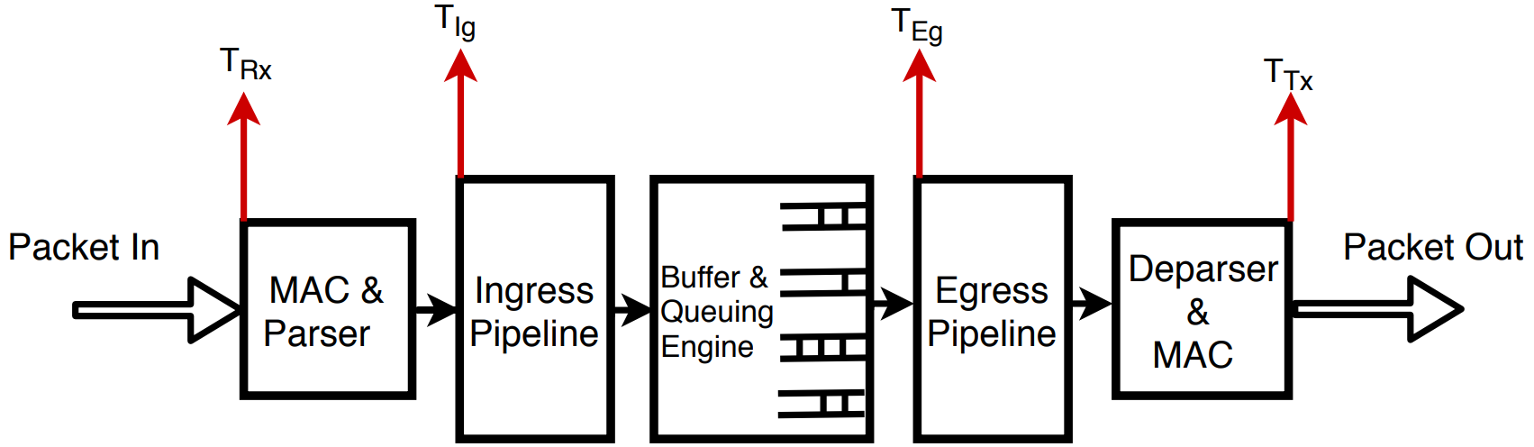
DPTP (Time Synchronization in the Dataplane)
Plus: High Precision Hardware Timestamps in the Processing Pipeline
Challenges: But there are lots of details to manage!

Slide 12
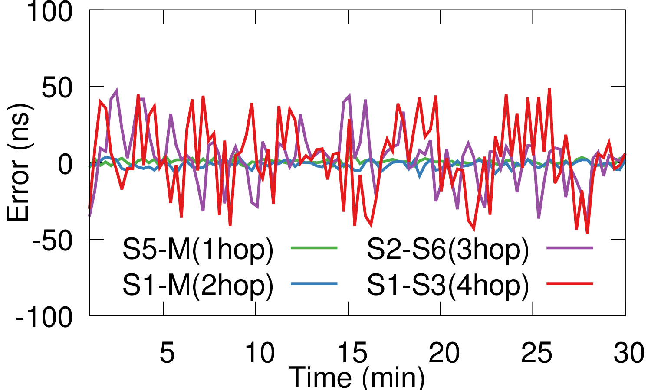
Line-rate traffic along the direction of the response packet.

Slide 13
Link failure management (ICNP 2019, SIGCOMM 2023)
Link failure management
Link failure detection
(e.g., F10)
Route recovery
Packet loss recovery
Host-based
(e.g., TCP)
Protection
(e.g., Conga, Hula, SPIDER)
Restoration
(e.g.
Sharebackup)
Host-based pkt loss recovery can lead
to much longer flow completion time (FCT) for short flows
Notes:
Current link failure management methods include three parts.
First is link failure detection.
Second is route recovery which use the preconfigured backup path or a reconfigured path by a remote controller. Even with a preconfigured backup path on the switch, there still has some packets lost while detecting the link failure.
Thus, after new route is ready, lost packet have to reply on the end host to be retransmitted.
However, this host based pkt loss recovery leads to a long flow completion time.

Slide 14
Our solution: SQR
Link failure management
Link failure detection
(e.g., F10)
Route recovery
Packet loss recovery
Protection
(e.g., Conga, Hula, SPIDER)
Restoration
(e.g.,
Sharebackup)
Host-based
(e.g., TCP)
Host-based
(e.g., TCP)
In-network
(SQR)
The network is the “right” place to perform packet loss recovery
Notes:
Instead of tcp retransmission from the sender, we propose SQR, an in-network mechanism to recover packets that could be lost during the period from the detection of a link failure to the subsequent network reconfiguration.

Slide 15
SQR
Objective:
Mask the effect of packet loss from the end-points during link failure detection time and route reconfiguration time (route failure time).
Key idea:
Continuously cache recently sent packet in the switch for a duration equal to the time needed to detect failure and reconfigure route.
Notes:
To keep a reliable FCT under link failure, SQR tries to avoid RTO as to completely mask the effect of packet loss and the resulting long recovery latency.
Our key insight is …
We argue that the network should take the responsibility for packet loss recovery instead of relying on end-to-end recovery.
Our key idea is …
So that we can prevent packet loss in he network under link failure.

Slide 16
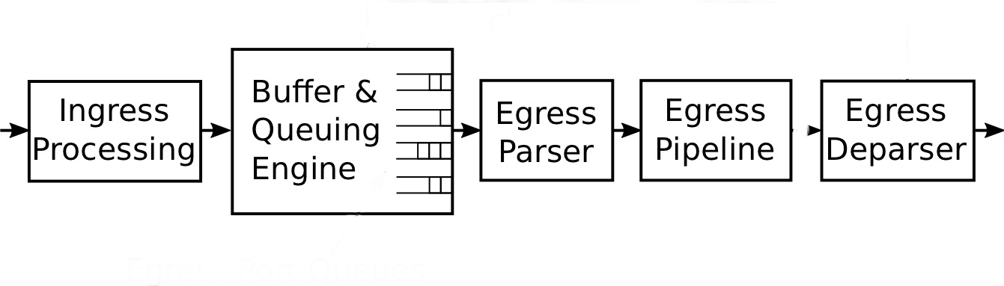
Where and how to cache?
Challenges
The default FIFO queues send out packets as fast as possible.
No BQE today readily provides the queuing discipline required to realize packets caching with a fixed time.
BQE does not support custom packet scheduling algorithms.
In a switch dataplane, the packets can only be stored in the packet buffer within the buffer & queuing engine (BQE).

Slide 17
Solution
Keep recent copies of transmitted packets by cloning and then recirculating cloned packets to BQE.
        Supported by the Portable Switch Architecture (PSA)
    Packets are cached for durations sufficiently long to detect link failure and perform route recovery.
    Resend cached packets to new route when it is available.
Notes:
We still use fifo queue within the BQR, but we also use egress pipeline and clone_e2e primitive to send copied pkts back to the BQE multiple times until initial pkts have been transmitted to next hop successfully or we has detected link failure.
Doing this, we will face three problems:
First, after it caches for a route failure time, and if there is no link failure, it will be dropped. Otherwise it will be sent to the backup port.Thus, we need to count time to see if the pkt has been cached for sufficient time.
Second, circulating pkts will affect egress processing and thus affect ongoing traffic.
Third, it will cause pkt reordering problem.
We design SQR to solve these three problems.

Slide 18
Challenges
        “Aging” of packets
        Load balancing of circulating packets
        Handle packet reordering
Notes:
We still use fifo queue within the BQR, but we also use egress pipeline and clone_e2e primitive to send copied pkts back to the BQE multiple times until initial pkts have been transmitted to next hop successfully or we has detected link failure.
Doing this, we will face three problems:
First, after it caches for a route failure time, and if there is no link failure, it will be dropped. Otherwise it will be sent to the backup port.Thus, we need to count time to see if the pkt has been cached for sufficient time.
Second, circulating pkts will affect egress processing and thus affect ongoing traffic.
Third, it will cause pkt reordering problem.
We design SQR to solve these three problems.

Slide 19
Overview
No packet loss
  Cache a copy of sent packets for a duration at least equal to the route failure time
  Pkt is sent to backup port if new route is ready
Packets in order
  Recover lost pkts based on pkt tag
Minimize egress processing delays on other flows going through the switch
  Select caching queue from multiple ports
  Dynamic least loaded port selection
Complements existing methods of link failure detection and route reconfiguration
SQR handles link failure, LinkGuardian (SIGCOMM 2023) handles gray failure.

Slide 20
Network Monitoring

Slide 21


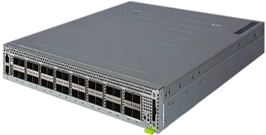
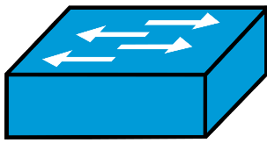
Background - Network Measurement
Control Plane – Complex but periodic
Security Attack (e.g., DDoS)
Fault Identification
Traffic Characteristics
Diverse Measurements Tasks:
Flow size
Cardinality
Heavy hitters/ changes
Flow size dist.
Entropy
Control
Traffic
info.
Data Plane – Simple but Real-time
Packet scheduling
Proactive congestion control
Fine-grained microburst analysis
Anomaly detections
Switch OS
Programmable Switch
Notes:
For the control actions across all, diverse network measurements are needed.

Slide 22


Sketch Algorithm
Sketch is a compact data structure for counting with
Constant number of memory access
Small memory/operation footprints
Over-estimation Error
Example : Count-Min
5
X
X
X
Set of “counters”
Hash 1
+1
5
X
Hash 2
+1
4
$$=\min\left(5, 4, 3\right)=3$$
X
Hash 3
+1
3
Insertion
Query
Notes:
Because of these constraints, a compact data structure so called sketch has been widely used by its simplicity like constant number of memory access.
Here is the most famous algorithm, Count-Min sketch.
[click] Count-Min use multiple independent counter arrays.
[click] When a new packet comes in, we select a counter of each array by hash offset and increase them.
To query the count of the flow, we take the minimum of the counters to avoid the over-estimation error by hash collision.
Count-Min is used in many works for in-network measurement.

Slide 23
Inefficiency in Count-Min Sketch
→ Counters must be large enough
  Skewed traffic distribution, common in DCNs^{1,2}
Freq.
Flow size
Problem: Memory Under-utilization
  Counter’s significant bits are wastefully unused
32-bit
00000...11010
unused
Theophilus Benson et al, Network Traffic Characteristics of Data Centers in the Wild, IMC’10
Tian Pan, et al. "Sailfish: Accelerating cloud-scale multi-tenant multi-service gateways with programmable switches." SIGCOMM 2021
Notes:
However, the Count-Min is memory-inefficient. More specifically, the counter’s significant bits are under-utilized whereas the switch’s memory is highly limited.
This is because in datacenters, flows are most likely small, but counters must be large enough as we don’t know in advance where large flows would be mapped to which counter.

Slide 24


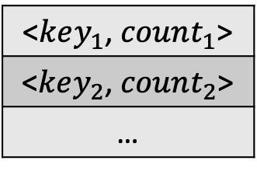
Advanced Sketch Design
Separating small and large flows
  [ElasticSketch, SIGCOMM’18], [ASketch, SIGMOD’16], etc
Large flows?
8-bit
<$key_{1}$, $count_{1}$>
<$key_{2}$, $count_{2}$>
…
Y
X
N
Small flows!
Complex to sort/filter the large flows on switch’s pipeline arch.
Notes:
To enhance the memory efficiency,
One way is to separate large and small flows by filtering large flows beforehand and use only small-size counters. However, precisely sorting and filtering large flows is too complex on the switches with a large resource overhead.

Slide 25

FCM Data Plane – Data Structure
FCM – Feed-Forward Count Min Sketch
A tree-based data-structure that easily fits to the pipeline switching architecture
pkts
Key idea:
Isolate small flows to only small-size counters
in the early stage
Large-size
(e.g., 16/32bit) – Few
Small-size (e.g., 4/8bit) - Many

Slide 26
FCM Data Plane – Data Structure
Example - Insertion
1
0
hash
0
0
f1
0
0
0

Slide 27
FCM Data Plane – Data Structure
Example - Insertion
2
0
hash
0
0
f1
0
0
0

Slide 28
FCM Data Plane – Data Structure
Example - Insertion
Count overflow-indicator
(i.e., TRUE if counter is full)
FULL
A
overflow
0
1
hash
0
0
f1
0
0
0

Slide 29
FCM Data Plane – Data Structure
Example - Insertion
FULL
A
overflow
1
1
0
f2
hash
0
0
0

Slide 30
FCM Data Plane – Data Structure
Example - Insertion
FULL
A
overflow
1
1
0
f3
f3
hash
2
0
0

Slide 31
FCM Data Plane – Data Structure
Example - Insertion
FULL
A
overflow
1
f4
1
f3
3
f3
f3
2
overflow
B
hash
A
overflow
FULL
FULL

Slide 32

FCM Data Plane – Data Structure
Example - Count Query
FULL
f1
A
overflow
1
A + 1
f2
1
1
A + B + 3
3
2
f3
2
overflow
B
(1) Collision reduction: Isolating small flows at earlier stages with less hash collisions
f4
A
overflow
FULL
FULL
Reduce false-positive with more small counters

Slide 33

Feed-forward Count-Min (FCM)
ML-based recovery of information loss by hash collision
Control Plane
Anomaly
Detection
Generic Measurement
Heavy Change
Entropy
Load
Balancing
Flow Size Distribution
Switching Pipeline
Virtual counters
Data Plane Query
Generic Apps
Data Plane
Collect
Queue
Measurement
Data Plane Query
Flow Size
Network
Scheduling
Cardinality
Heavy Hitter
FCM-Sketch
Data Plane Apps
Packet in
Packet out
Notes:
Our framework consists of two parts.
First, in the data plane, we design a novel data structure, FCM-Sketch, that supports the queries like flow size, number of unique flows, and heavy hitters, entirely in the data plane.
In the control plane, we periodically collect the sketch and run ML-based loss recovery to provide an accurate statistics like entropy and flow size distribution.
Now, let’s see FCM-Sketch’s data structure in the data plane.

Slide 34
Evaluation on Software
Task-specific : CM, CU, Pyramid with CM (PCM), Hyperloglog (HLL), MRAC.
Generic tasks : UnivMon, ElasticSketch-P4.
Flow size | FCM | CM | CU | PCM | ElasticP4 | FCM+TopK
Norm. Error Metric | 1.00 | 5.87 | 3.40 | 2.02 | 2.18 | 0.81
Cardinality | FCM | HLL | - | UnivMon | ElasticP4 | FCM+TopK
Norm. Error Metric | 1.00 | 0.886 | - | 26.56 | 19.85 | 1.08
Flow size distribution | FCM | MRAC | - | - | ElasticP4 | FCM+TopK
Norm. Error Metric | 1.00 | 2.12 | - | - | 1.04 | 0.82
Entropy | FCM | MRAC | - | UnivMon | ElasticP4 | FCM+TopK
Norm. Error Metric | 1.00 | 1.54 | - | 4.97 | 1.52 | 0.31
Lower is better!
Notes:
Now we present evaluation results.
In the software evaluation, we use the same memory size, and evaluate FCM with existing measurement solutions.
Here, we normalize the errors to FCM-Sketch to make the simple comparison.
As we can see, FCM-Sketch outperforms both the task-specific algorithms and sketches supporting generic measurements.

Slide 35
FCM looks at a single switch, but you also need to collect statistics about the network with many switches!
Build a “better” network debugger (NSDI 2021)

Slide 36
Microbursts (µbursts)
Events of intermittent congestion lasting 10’s or 100’s of µs
  Common Causes: TCP Incast, Bursty UDP traffic TCP Segment offload
Senders
Receiver
……
Detecting & characterizing µbursts is hard
  Last for less than hundreds of µs
  Occur unpredictably
Notes:
Microbursts are events of intermittent congestion that last for 10’s or 100’s of μs.
The common causes are TCP Incast scenarios, bursty UDP traffic from an offending flow, as well as TCP segment offloading
Intermittent increases in latency leads to variability in the network.
Microbursts also cause network jitter and packet loss in data center networks.

Slide 37



Solution Outline
Visibility
Retrospection
Correlation
Keep small amount of
compressed packet records
in switch memory
Data-Plane
Time Synchronization
DPTP[SOSR ‘19]
DTP[SIGCOMM ‘16]
Export recent history of
packet records
on fault detection
SyNDB
Notes:
So, How do we solve this problem of getting visibility and retrospection from the network?
Leveraging Programmable switches,
We record the packets as compressed packet records with telemetry inside the switch memory itself
Next, since we cannot afford to flush the recorded data all the time due the overheads involved as previously mentioned, we design a fault-detection system in the network data-plane to selectively export the recorded history to controller for debugging.
Finally, we need to correlate the collected precords at high resolution. For this purpose,, we leverage recent data-plane time synchronization protocols , which provides nanosecond-level time synchronization between the data-plane clocks of the switches in the network . Hence, global time is available in the switch-dataplane while maintaining the precords.
With these three complementening techniques covering visibility, retrospection and corelation, we develop Synchronized network debugger (SyNDB)

Slide 38

Packet Records
Compression : Packet Records
(precords)
S5
S10
Ingress Port
Hash | Time_{In} | Time_{Queue} | Stat
Ring Buffer
in switches
S9
Time-Synchronization
using DPTP
S3
S4
S8
S1
S2
S6
S7
H1
H2
H3
H4
H5
H6
H7
H8
Notes:
Now, let me go into the details of of our solution,
In Syndb, the switch data-plane clocks are synchronized using a recent data-plane timesynchronization protocol (called dptp)
Each switch maintains a recording ring buffer which compresses and stores packets record (we call it precord) upon reception of a packet. A precord typically contains a hash of the packet header, time it entered the switch, and amount of time it queued. Additionally, it can contain custom statistics that can be configured by the operator, lets say ingress port from which the packet came.
The key idea is to leverage the switch data-plane as a fast temporal storage to do continuous recording of records as a moving time window.
When no network fault is detected, the recording window moves ahead and the older packet records beyond the record time-length is discarded.
Hence, this ring buffer always maintain the recent history of events/packets.

Slide 39
In-Network Fault Detection
S5
S10
Programmable
Fault Triggers
e.g.
Queueing delay > Threshold
S3
S4
S8
S9
High Queueing
due to Burst
S1
S2
S6
S7
H1
H2
H3
H4
H5
H6
H7
H8
Synchronized Fan-In Traffic
Notes:
Next, the history of precords is needed when a network fault occurs.
To do this, SyNDB allows operators to program custom fault trigger conditions.
For example, the operator could configure the trigger to be high queueing delay for packets which means congestion.
Now during network operation, lets consider a synchronized fan-in traffic from many hosts to single hosts, causing incast thus, leading to high queueing delays at switch S7

Slide 40

Packet record Collection
Collector
(Debugger)
S5
S10
1) Notify the entire
Network
2) Send Records
to collector
S3
S4
S8
S9
High Queueing
due to Burst
S1
S2
S6
S7
H1
H2
H3
H4
H5
H6
H7
H8
Notes:
Upon Trigger hit at S7, it notifies all other switches, and all switches in the network freeze their ring buffer.
Now, collection happens individually in each switch and all the precords are evicted and sent to the collector via control-plane channel without affecting the data-plane traffic.
Since, timestamp is attached to every precord, collection can be performed out-of-order and collector can easily re-order them

Slide 41
SyNDB Evaluation (Non-Synchronized Fan-In)
Microburst detected at the link S7 -> H8
H1 to H6 send to H8
H9 to H6

Slide 42
Use Cases
Routing Bugs due to timing issues
App Timing Bugs
Traffic Pattern Analysis
Routing Loops
Network Configuration Updates
Transient Load Imbalances

Slide 43
Network Application:
Datacenter Load Balancing

Slide 44





Remote Direct Memory Access (RDMA)
RDMA is the emerging standard in modern DCs
Application
Buffer
Host OS (TCP)
RDMA NIC
+ probably more !
Performance
Versatility
Practicality
High throughput
Low latency
Low CPU overhead
RDMA + RPC
RDMA + Storage
RDMA + AI/ML
Production-level deployment in DCs
[1] Gao, Yixiao, et al. “When cloud storage meets RDMA”. NSDI 2021
[2] Bai, Wei, et al. “Empowering azure storage with RDMA”. NSDI 2023

Slide 45

Network Load Balancing for RDMA
Despite such benefits, RDMA does not fully exploit the
high path diversity in DCNs.
Existing LB schemes do not fit well with RDMA.
Why, and what is the solution?

Slide 46
Prior Load Balancing Designs
Per-flow
Per-flowlet
Per-packet
Coarsed-grained
Reroute
granularity
Fine-grained
ECMP (Equal Cost Multi Path) is de-facto standard for RoCEv2*
Cannot evenly distribute flows based on their sizes
Per-flowlet rerouting avoids out-of-order arrivals via timegaps
Hard to find time gaps in RDMA
Per-packet rerouting provides a near-optimal load balance
RDMA is highly sensitive to out-of-order packets

Slide 47

Design Goal
How to get here?
Fine
grained
Per-packet
Reroute
granularity
Per-flowlet
(for TCP)
Per-flowlet
(for RDMA)
Coarsed
grained
Better
Per-flow
Out-of-order
Preserving pkt order
In-order

Slide 48

Idea – In-network Packet Reordering
“Restore” packets back in-order before reaching to end-hosts
Opportunity
~128 FIFO queues per Eg. port
Intel Tofino2
Programmable Switch
Queue pause/ resume capability

Slide 49

Challenges in Packet Reordering on Switches
Hard to restore “arbitrary” packet orders on switches:
  Lack of sorting primitives on switching hardware
Limited resource and time for storing and flushing packets at line-rate
Costly to store pkts to FIFO queues and flush them
1
2
3
4
Next SEQ = 1
flush in relays
FIFO queues

Slide 50
Challenges in Packet Reordering on Switches
Hard to restore “arbitrary” packet orders on switches:
  Lack of sorting primitives on switching hardware
Limited resource and time for storing and flushing packets at line-rate
Costly to store pkts to FIFO queues and flush them
How to “constrain” the packet
reordering patterns?
1
4
Next SEQ = 1
3
flush in relays
2
FIFO queues

Slide 51




ConWeave (short for Congestion Weaving)
Key Components in ConWeave
Path Monitoring
Path Selecting
Cautious Rerouting
Pkt Reordering
Agile and lightweight
congestion detection
Telemetry-driven
congestion evasion
Tight incorporation with
switch’s reordering capability
Efficient queue flush
via strict priority
This Talk!
* More details in the paper

Slide 52




Cautious Rerouting
Key Idea
Reroute “only if” there is no inflight out-of-order packets
→ Enable switch to reorder a flow using a single reorder queue
ConWeave SrcToR
ConWeave DstToR
Normal queue (for all flows)
Current path is congested!

Slide 53
Cautious Rerouting
Key Idea
Reroute “only if” there is no inflight out-of-order packets
→ Enable switch to reorder a flow using a single reorder queue
ConWeave SrcToR
ConWeave DstToR
Normal queue (for all flows)
T
Tag “TAIL” – last pkt before rerouting

Slide 54
Cautious Rerouting
Key Idea
Reroute “only if” there is no inflight out-of-order packets
→ Enable switch to reorder a flow using a single reorder queue
ConWeave SrcToR
ConWeave DstToR
Normal queue (for all flows)
T
Reroute!

Slide 55
Cautious Rerouting
Key Idea
Reroute “only if” there is no inflight out-of-order packets
→ Enable switch to reorder a flow using a single reorder queue
ConWeave SrcToR
ConWeave DstToR
Normal queue (for all flows)
T
Reroute!
Out-of-order!

Slide 56
Cautious Rerouting
Key Idea
Reroute “only if” there is no inflight out-of-order packets
→ Enable switch to reorder a flow using a single reorder queue
ConWeave SrcToR
ConWeave DstToR
Normal queue (for all flows)
T
Reroute!
Reorder queue
Dynamically assign reorder queue!

Slide 57
Cautious Rerouting
Key Idea
Reroute “only if” there is no inflight out-of-order packets
→ Enable switch to reorder a flow using a single reorder queue
“TAIL” says that all packets from
OLD path have arrived
→ Flush reorder queue
ConWeave SrcToR
ConWeave DstToR
Normal queue (for all flows)
T
Reroute!
Reorder queue

Slide 58
Cautious Rerouting
Key Idea
Reroute “only if” there is no inflight out-of-order packets
→ Enable switch to reorder a flow using a single reorder queue
ConWeave SrcToR
ConWeave DstToR
Normal queue (for all flows)
T
Reroute!
Release the reorder queue, and
redirect a flow to normal queue
Reorder queue

Slide 59
Cautious Rerouting
Key Idea
Reroute “only if” there is no inflight out-of-order packets
→ Enable switch to reorder a flow using a single reorder queue
”CLEAR” – no more inflight
out-of-order packets
ConWeave SrcToR
ConWeave DstToR
Normal queue (for all flows)
Reroute!
Release the reorder queue, and
redirect a flow to normal queue
Reorder queue

Slide 60

Cautious Rerouting
Key Idea
Reroute “only if” there is no inflight out-of-order packets
→ Enable switch to reorder a flow using a single reorder queue
(0) Monitoring*
TAIL
(1) Reroute
(2) Buffer
”CLEAR” – no more inflight
out-of-order packets
ConWeave SrcToR
ConWeave DstToR
(3) Flush
CLEAR
Normal queue (for all flows)
ConWeave reroutes a flow when congestion is detected*
while delivering packets in order
* More details in the paper

Slide 61
Network Application:
5G/6G Radio Access Network (RAN)

Slide 62


Evolution of the Radio Access Network
Core Network
Core Network
CU
BBU
DU
DU
BBU
BBU
Legacy RAN
Virtualized and Disaggregated RAN
Notes:
Next, we will move on to talk about the RAN.
Over the years, the RAN itself has undergone a series of major transformation.
Traditionally, it was built using tightly integrated, proprietary hardware.
Today, it has evolved into a virtualized and disaggregated architecture, whereby the RAN now runs on commodity servers, and the base station is broken down into components like the CU and DU.

Slide 63
Traditional Cellular Network Setup
Radio Access
Network
Frontend
Fronthaul
Host/Server
Mobile
1
Core
Network
Host/Server
2
Notes:
Lets take a look at the cellular network architecture prior to 5G. Traditionally, cellular networks had a homogenous set of users
*CLICK* connected to base stations. These base stations are collectively make up the frontend.
*CLICK* Base stations are then connected to the Hosts/Servers which are responsible for converting digital bits to analog signals and vice versa.
*CLICK* The network connecting the base stations to the Hosts/Servers is known as the Fronthaul whereas the Hosts responsible for converting digital bits to analog signals are collectively known as the Radio Access Network.
*CLICK* These Hosts/Servers are often placed together in a centralized cloud referred to as the Cloud RAN. Note that each base station is connected to exactly one host/server which is responsible for processing all users connected to the base station. This constraint is a major drawback as cellular networks, start serving users from different use cases.

Slide 64
Need to Diverse Application
Constant upgrade to support larger number devices
Overprovisioning to support different QoS
Specialized processors for RAN processing
Host/Server
Host/Server
1
Host/Server
2
Inefficient scaling with increasing number of devices
and use cases
Notes:
*CLICK* First Hosts in the cloud need to be upgraded as number devices in the network continue to increase as users connected to the same base station cannot be processed on different hosts.
*CLICK* Hosts also need to be overprovisioned to support increasing number of use cases with different QoS requirements such low latency, high throughput.
*CLICK* To achieve these varying QoS requirements, hosts in the RAN need to use specialized processors such as DSPs and ASICs for RAN processing; thus requiring a significant hardware modification each time a new use case is introduced.
*CLICK* All these factors make existing architecture unable to scale efficiently with increasing number of devices in network.

Slide 65
Proposed Architecture
Radio Access
Network
Frontend
Fronthaul
Hosts/Servers
Host/Server
1
Host/Server
Hosts/Servers
Host/Server
2
Notes:
The proposed architecture removes the constraint and allows users from same use case to be processed together.
*CLICK* Users from the same use case can also be processed on multiple hosts to ensure operators need to only add new hosts to support new devices. As you can see here, users from the yellow use case connected to the same base station can now run on different hosts. Additionally, operators can also use off-the-shelf hardware for most use cases to reduce costs, while still having the ability to use specialized hardware for a small subset of critical use cases.

Slide 66
Key Insight
Network Scheduler
Hosts/Servers
Host/Server
Wireless
Schedule
Fronthaul Packets
Hosts/Servers
All transmissions in the network are scheduled and hence the sequence of packets in the fronthaul is known in advance.
Update routing table in switch at high frequency according to the resource schedule (~ 10⁶ updates per base station)
Notes:
The key insight to solve this challenge, is that all transmissions in the cellular network are schedule by a
*CLICK* network scheduler in advance. This implies that sequence of packets in the fronthaul which carries digitized radio signals is known in advance because of the network scheduler. However,

Slide 67
Hardware Accelerated Central Unit (CU)
Core Network
CU
DU
DU
Virtualized and Disaggregated RAN
XZ Khooi et al, How to Hardware Accelerate Your 5G CU, IEEE Infocom 2026

Slide 68
Overview
Loki presents a hierarchical CU design
  complements existing software CUs using commodity hardware
  migrates user traffic processing to hardware for acceleration, whenever feasible
Loki comprises two key systems:
  Migration Manager
    decides on which user to migrate
  Stateful Migration Protocol
    seamlessly migrate users between software and hardware
    End

Slide 69

In-band Stateful Migration Protocol
In-band approach
  Synchronization of the PDCP SNs are done entirely in the data plane
There are two parts of the protocol:
  Software-to-Hardware Migration (“offloading”)
    from CU-UP to network infrastructure
  Hardware-to-Software Migration (“eviction”)
    from network infrastructure to CU-UP
Notes:
// mention that we have a policy
// there are more users that the hardware can support
// applicable on hardware can move

Slide 70
In-band Stateful Migration: Challenges
Lossy networks
  SYNC packet could be lost, causing migration stalls
Out-of-order processing/ forwarding
  packets (including SYNC) maybe be processed out-of-order at HW
  cannot ensure PDCP SN carried by SYNC is the most recent
Out-of-order uplink packet arrivals
  wireless retransmissions can cause packets to arrive out-of-order
Notes:
// PROCESSING SPEED DIFFERENCE? SOFTWARE VS HARDWARE

Slide 71
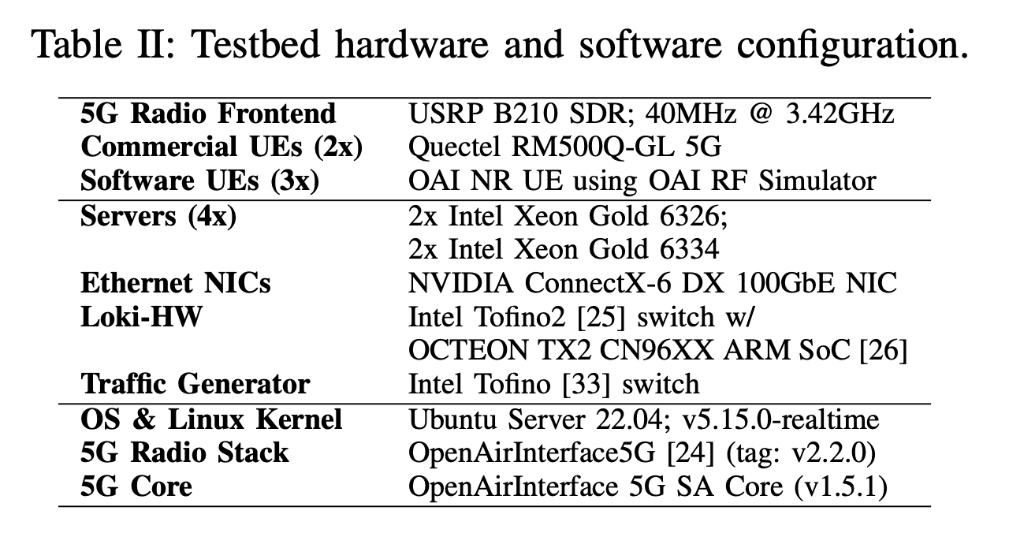
Evaluations
Load testing with synthetic traffic
End-to-end system validation using real UEs
  Demonstrate protocol robustness
  System can dynamically adapt w.r.t. ongoing traffic changes
  Impact of CPU performance
Microbenchmarks
Notes:
// MENTION THAT WE HAVE MEASURED THE SCALABILITY

Slide 72
Key Result: Protocol Robustness
iPerf3
We frequently trigger migration periodically between HW and SW
  demonstrating the robustness of the stateful migration protocol
We observe impact of migration on the application performance
  any latency spikes?
  any throughput degradation?
From the results, no impact observed on the application
Ping
Notes:
// need time to explain
// focus on downlink

Slide 73








Joint Work with
Pravein Kannan
Raj Joshi
Nishant Budhdev
Chahwan Song
Xin Zhe Khooi
Ting Qu
Satis Permal
Ben Leong

Slide 74
Questions?

